Slide 1
DIGITAL SIGNAL PROCESSING
Master Computer Vision 2017 – 2018
Jean-Marie BILBAULT
bilbault@u-bourgogne.fr

Slide 2
Programme of lectures for semester 1.
Academic year 2017 – 2018
Course Module : Digital Signal Processing
50 hours, 1 weight, 6 ECTS
Module DSP Coordinator : Jean-Marie Bilbault
Tel : 33 6 63 84 13 66
e-mail : bilbault@u-bourgogne.fr

Slide 3
Syllabus :
1) Review about analog signals: time and spectral representations. Fourier Transformation. Fourier Transform properties. Case of periodic functions.
2) Discrete-time signals. Sampling, Nyquist frequency and aliasing. Decimation, rate conversion and oversampling.
3) Fast Fourier Transform (FFT). Hardware and software structures for FFT implementation…
4) Random signals. Probability density functions. Relations between correlation and convolution…
5) Linear systems and digital filtering. Revision of Z-transform, time and frequency responses. Introduction to digital filters.
6) FIR filters, window functions. 7) IIR filters, bilinear transform

Slide 4
Functional Analysis of Signals and Systems
Signal Processing is a basical ground theory useful for any communication problem. It is devoted to study signals in connection with systems that transmit them, but without study of system constitution.
Indeed, we will consider a system as a box with input signal e(t) and output signal s(t), such as:
e(t)
s(t)
A signal is a mathematical model allowing to represent a measure of a real physical quantity such as temperature, voltage, current, … often given by sensors. In signal processing, most signals are voltages (scalar in 1D signals or vectorial in systems with more dimensions).
Depending of signal characteristics, one can consider analog, sampled, digital signals.
For analog signal, t ϵ R → s(t) ϵ R or C
For sampled signal, k ϵ Z → s(k) ϵ R or C
For digital signal, k ϵ Z → s(k) = n.q , with q real number and n ϵ Z.

Slide 5
In this lecture, we will consider analog signals, that is real or complex valued-functions of time, where time is a continuous parameter.
Then, mathematical properties such as continuity, derivative, integrals, … can be used. And it leads to differential equations relating input and output signals.
Consider as a basic example the following circuit, called first-order linear filter.
Applying Kirchhoff equations between current and voltages yields:
s(t) + RC ds(t)/dt = e(t)

Slide 6
Linear systems: they obey to the superposition theorem:
If e₁(t) and e₂(t) are 2 independant signals whose answers through the system are respectively s₁(t) and s₂(t), any linear combination α e₁(t) + β e₂(t) will give the answer: α s₁(t) + β e₂(t)
Stable systems: If the system is such that for e(t) = Dirac impulse δ(t), its answer remains inside a fixed interval [ - A, + A], with A a real finite number, the system is called stable in the large sense. In addition, if the answer tends to zero when the time t tends to infinity, the system is called stable in the strict sense.
Stationnary systems: s(t) being the answer of any input signal e(t) applied to the system, and τ being any real delay parameter, if s(t – τ) is the answer for the input e(t – τ), then the system is called stationnary.
Causal systems: If s( t < 0 ) remains zero for any input signal e(t) with e( t < 0 ) = 0, it is clear that the effect cannot come before the cause, the system is then called causal.
Dynamical systems: A system is called instantaneous if the answer s(t) to any input e(t) only depends on e(t) (and its derivatives) at the same time. Otherwise, the system is called to be dynamical… For example, s(t) can depend on its own derivatives.

Slide 7
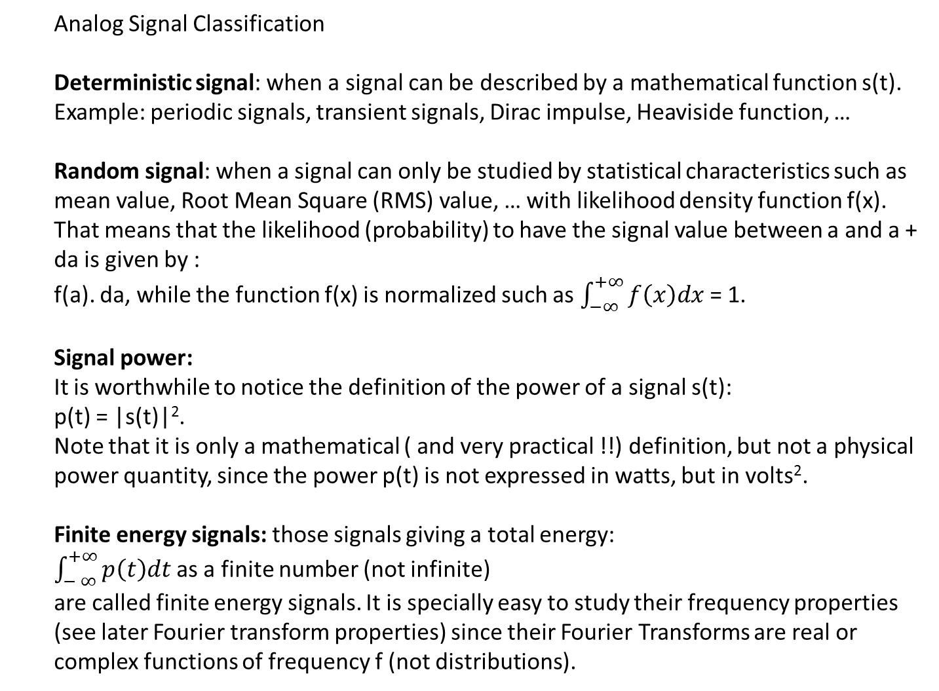
Analog Signal Classification
Deterministic signal: when a signal can be described by a mathematical function s(t). Example: periodic signals, transient signals, Dirac impulse, Heaviside function, …
Random signal: when a signal can only be studied by statistical characteristics such as mean value, Root Mean Square (RMS) value, … with likelihood density function f(x). That means that the likelihood (probability) to have the signal value between a and a + da is given by :
f(a). da, while the function f(x) is normalized such as $\int_{−∞}^{+∞}{f\left(x\right)dx}$ = 1.
Signal power:
It is worthwhile to notice the definition of the power of a signal s(t):
p(t) = |s(t)|².
Note that it is only a mathematical ( and very practical !!) definition, but not a physical power quantity, since the power p(t) is not expressed in watts, but in volts².
Finite energy signals: those signals giving a total energy:
$\int_{− ∞}^{+∞}{p\left(t\right)dt }$as a finite number (not infinite)
are called finite energy signals. It is specially easy to study their frequency properties (see later Fourier transform properties) since their Fourier Transforms are real or complex functions of frequency f (not distributions).

Slide 8
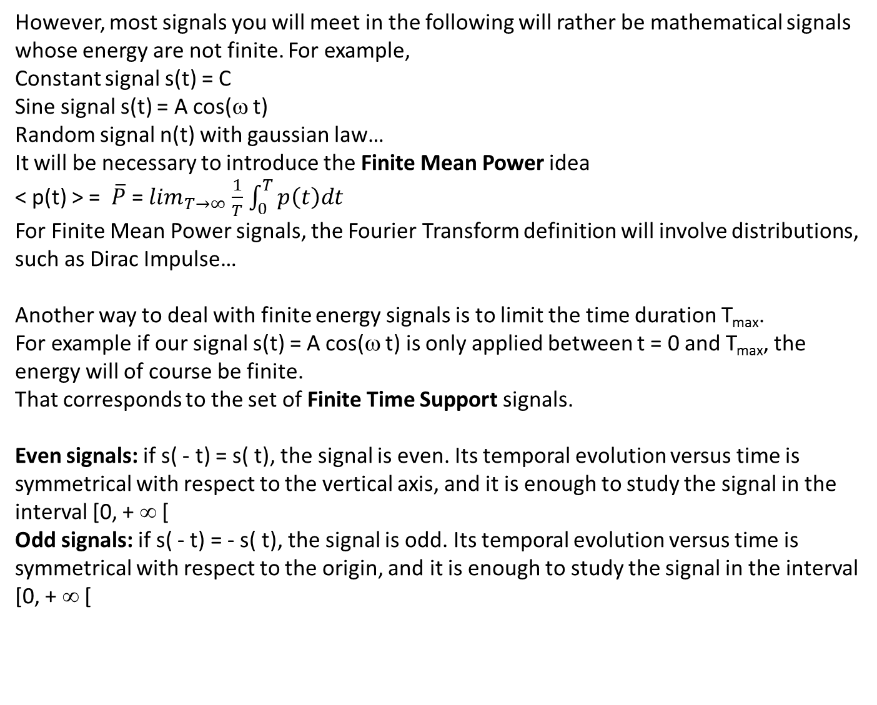
However, most signals you will meet in the following will rather be mathematical signals whose energy are not finite. For example,
Constant signal s(t) = C
Sine signal s(t) = A cos(ω t)
Random signal n(t) with gaussian law…
It will be necessary to introduce the Finite Mean Power idea
< p(t) > = $\overline{P}$ = $\lim_{T→∞}$ $\frac{1}{T}$ $\int_{0}^{T}{p\left(t\right)dt}$
For Finite Mean Power signals, the Fourier Transform definition will involve distributions, such as Dirac Impulse…
Another way to deal with finite energy signals is to limit the time duration T_{max}.
For example if our signal s(t) = A cos(ω t) is only applied between t = 0 and T_{max}, the energy will of course be finite.
That corresponds to the set of Finite Time Support signals.
Even signals: if s( - t) = s( t), the signal is even. Its temporal evolution versus time is symmetrical with respect to the vertical axis, and it is enough to study the signal in the interval [0, + ∞ [
Odd signals: if s( - t) = - s( t), the signal is odd. Its temporal evolution versus time is symmetrical with respect to the origin, and it is enough to study the signal in the interval [0, + ∞ [

Slide 9
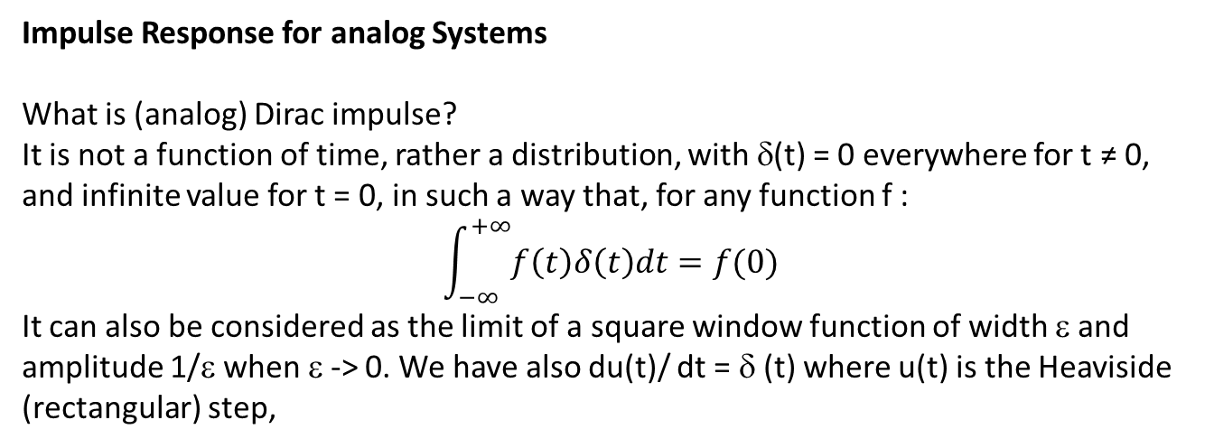
Impulse Response for analog Systems
What is (analog) Dirac impulse?
It is not a function of time, rather a distribution, with δ(t) = 0 everywhere for t ≠ 0, and infinite value for t = 0, in such a way that, for any function f :
$$\int_{−∞}^{+∞}{f\left(t\right)δ\left(t\right)dt=f(0)}$$
It can also be considered as the limit of a square window function of width ε and amplitude 1/ε when ε -> 0. We have also du(t)/ dt = δ (t) where u(t) is the Heaviside (rectangular) step,
e(t)
s(t)
The mathematical relation between e(t) and s(t) involves a convolution product:
s(t) = e(t) * h(t),
Where h(t) is called the Dirac impulse response.

Slide 10
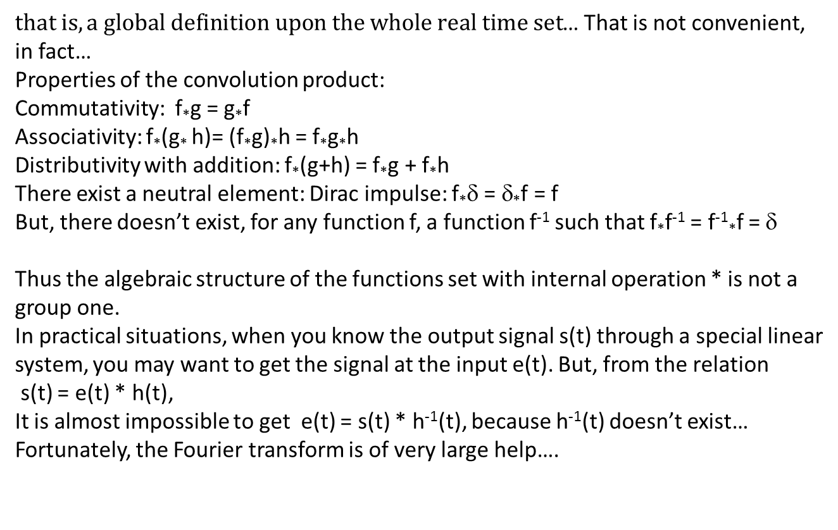
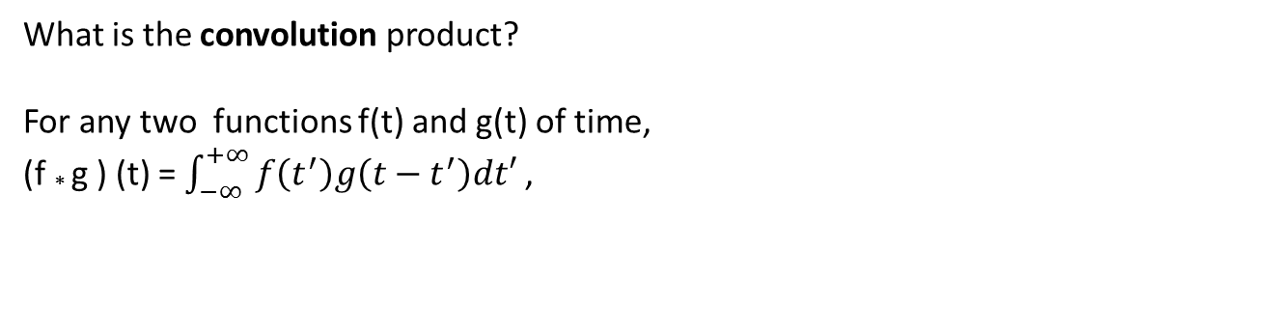
What is the convolution product?
For any two functions f(t) and g(t) of time,
(f * g ) (t) = $\int_{−∞}^{+∞}{f\left(t^{′}\right)g\left(t−t^{′}\right)dt′}$ ,
$that is, a global definition upon the whole real time set$… That is not convenient, in fact…
Properties of the convolution product:
Commutativity: f*g = g*f
Associativity: f*(g* h)= (f*g)*h = f*g*h
Distributivity with addition: f*(g+h) = f*g + f*h
There exist a neutral element: Dirac impulse: f*δ = δ*f = f
But, there doesn’t exist, for any function f, a function f⁻¹ such that f*f⁻¹ = f⁻¹*f = δ
Thus the algebraic structure of the functions set with internal operation * is not a group one.
In practical situations, when you know the output signal s(t) through a special linear system, you may want to get the signal at the input e(t). But, from the relation
s(t) = e(t) * h(t),
It is almost impossible to get e(t) = s(t) * h⁻¹(t), because h⁻¹(t) doesn’t exist…
Fortunately, the Fourier transform is of very large help….

Slide 11
Impulse response for the R, C circuit with equation s(t) + RC ds(t)/dt = e(t)
From Maths, we know that linear differential equations with constant coefficients can be solved with the sum :
the general solution for the equation without second hand member
+
A particular solution of the whole equation

Slide 12
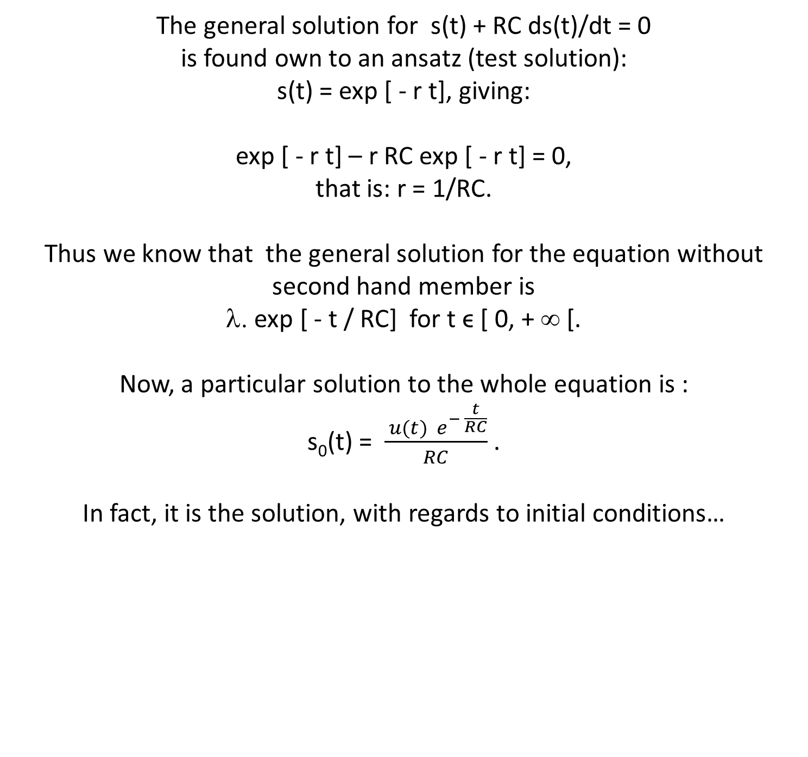
The general solution for s(t) + RC ds(t)/dt = 0 is found own to an ansatz (test solution): s(t) = exp [ - r t], giving: exp [ - r t] – r RC exp [ - r t] = 0, that is: r = 1/RC. Thus we know that the general solution for the equation without second hand member is λ. exp [ - t / RC] for t ϵ [ 0, + ∞ [. Now, a particular solution to the whole equation is : s₀(t) = $\frac{ u(t){ e}^{− \frac{t}{RC}}}{RC}$ . In fact, it is the solution, with regards to initial conditions…

Slide 13
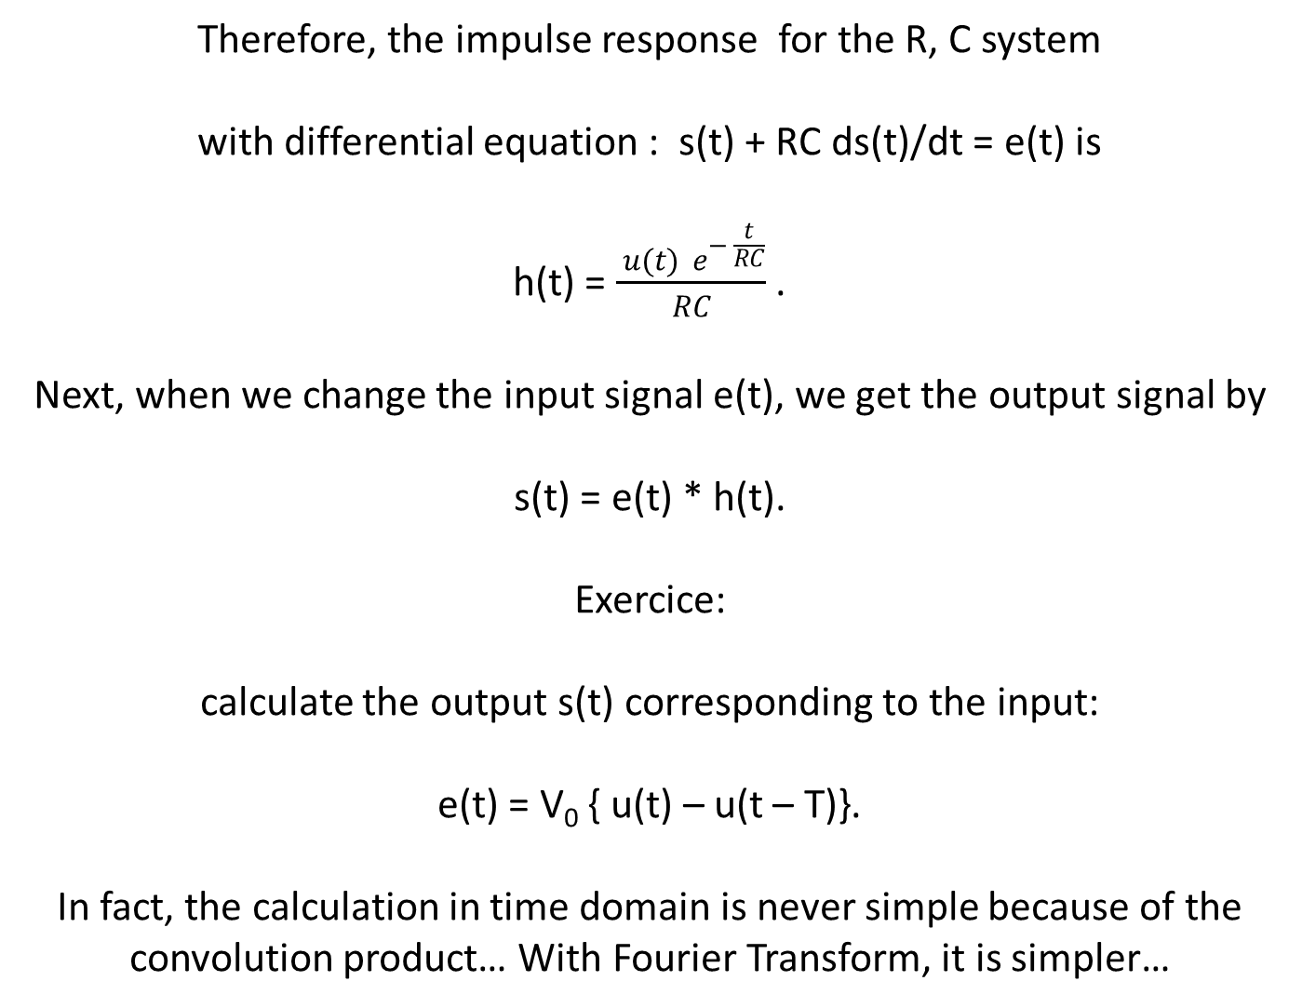
Therefore, the impulse response for the R, C system with differential equation : s(t) + RC ds(t)/dt = e(t) is h(t) = $\frac{ u(t){ e}^{− \frac{t}{RC}}}{RC}$ . Next, when we change the input signal e(t), we get the output signal by s(t) = e(t) * h(t). Exercice: calculate the output s(t) corresponding to the input: e(t) = V₀ { u(t) – u(t – T)}. In fact, the calculation in time domain is never simple because of the convolution product… With Fourier Transform, it is simpler…

Slide 14
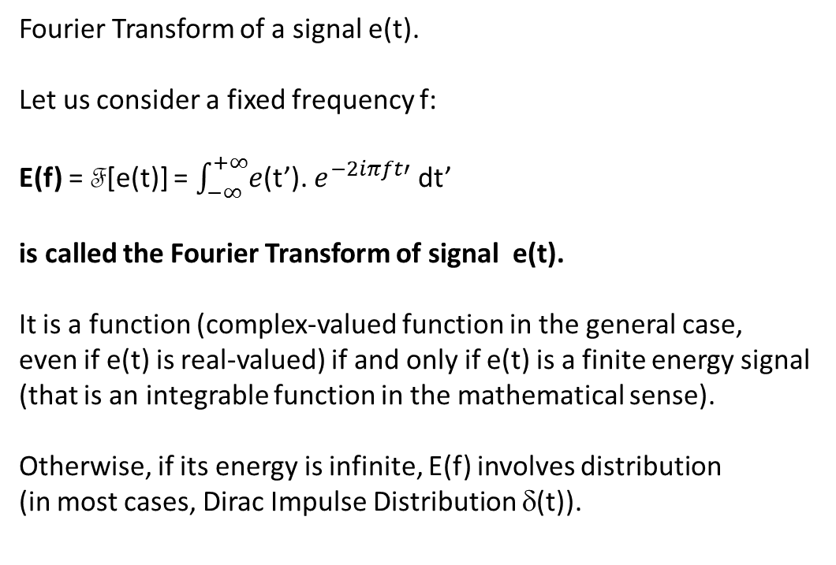
Fourier Transform of a signal e(t).
Let us consider a fixed frequency f:
E(f) = F[e(t)] = $\int_{−∞}^{+∞}{e}$(t’). $e^{−2iπft′}$ dt’
is called the Fourier Transform of signal e(t).
It is a function (complex-valued function in the general case,
even if e(t) is real-valued) if and only if e(t) is a finite energy signal
(that is an integrable function in the mathematical sense).
Otherwise, if its energy is infinite, E(f) involves distribution
(in most cases, Dirac Impulse Distribution δ(t)).

Slide 15
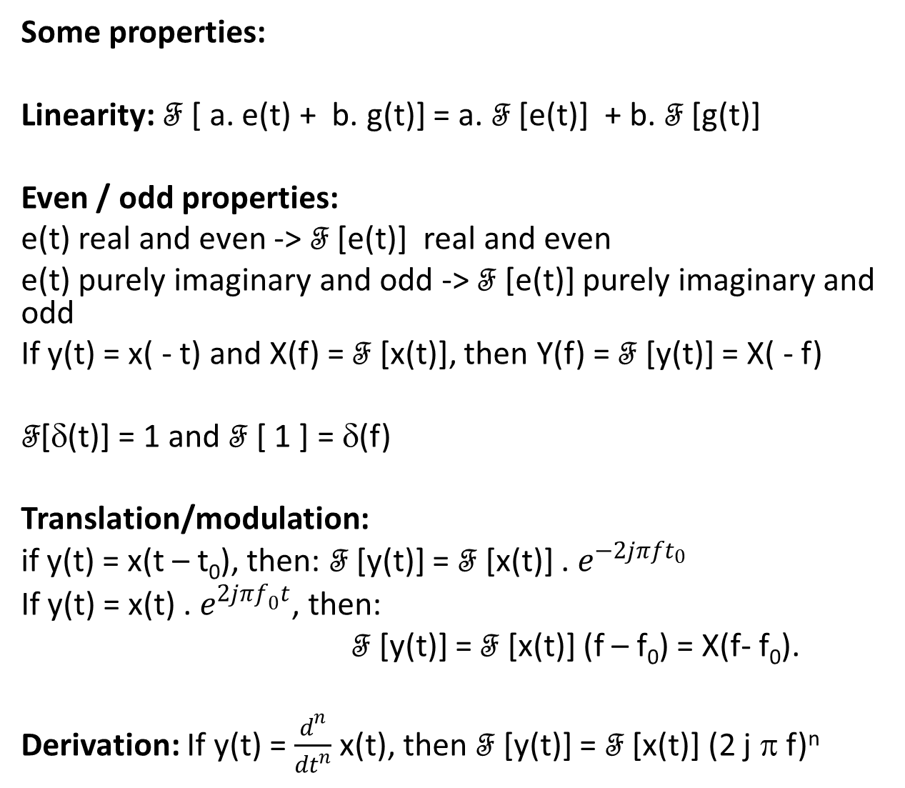
Some properties:
Linearity: F [ a. e(t) + b. g(t)] = a. F [e(t)] + b. F [g(t)]
Even / odd properties:
e(t) real and even -> F [e(t)] real and even
e(t) purely imaginary and odd -> F [e(t)] purely imaginary and odd
If y(t) = x( - t) and X(f) = F [x(t)], then Y(f) = F [y(t)] = X( - f)
F[δ(t)] = 1 and F [ 1 ] = δ(f)
Translation/modulation:
if y(t) = x(t – t₀), then: F [y(t)] = F [x(t)] . $e^{−2jπft_{0}}$
If y(t) = x(t) . $e^{2jπf_{0}t}$, then:
F [y(t)] = F [x(t)] (f – f₀) = X(f- f₀).
Derivation: If y(t) = $\frac{d^{n}}{dt^{n}}$ x(t), then F [y(t)] = F [x(t)] (2 j π f)^{n}

Slide 16
Some exercises
Give the Fourier transform of the following signal x₁(t), function of time t , called the rectangular symmetric window.
Give also the spectral energy density and check the validity of Parseval’s identity on this particular function.
x₁(t) = X₀ for t belonging to [ 0, T₀ /2]
x₁(t) = 0 elsewhere.
2) Another function x₂(t), called triangle function, can be defined as the convolution product x₂(t) = x₁(t)*x₁(t). Represent the time evolution of x₂(t) and study its Fourier transform.
3) Consider the even function
x₃(t) = X₀ for t belonging to [ 0, (T₀ – t_{r})/2]
and x₃(t) = X₀ /t_{r} [(T₀ + t_{r})/2 – t] for t belonging to [ (T₀ – t_{r})/2, (T₀ + t_{r})/2].
Represent the time evolution of x₃(t) and study its Fourier transform. Use logarithmic scales to represent the spectrum.

Slide 17
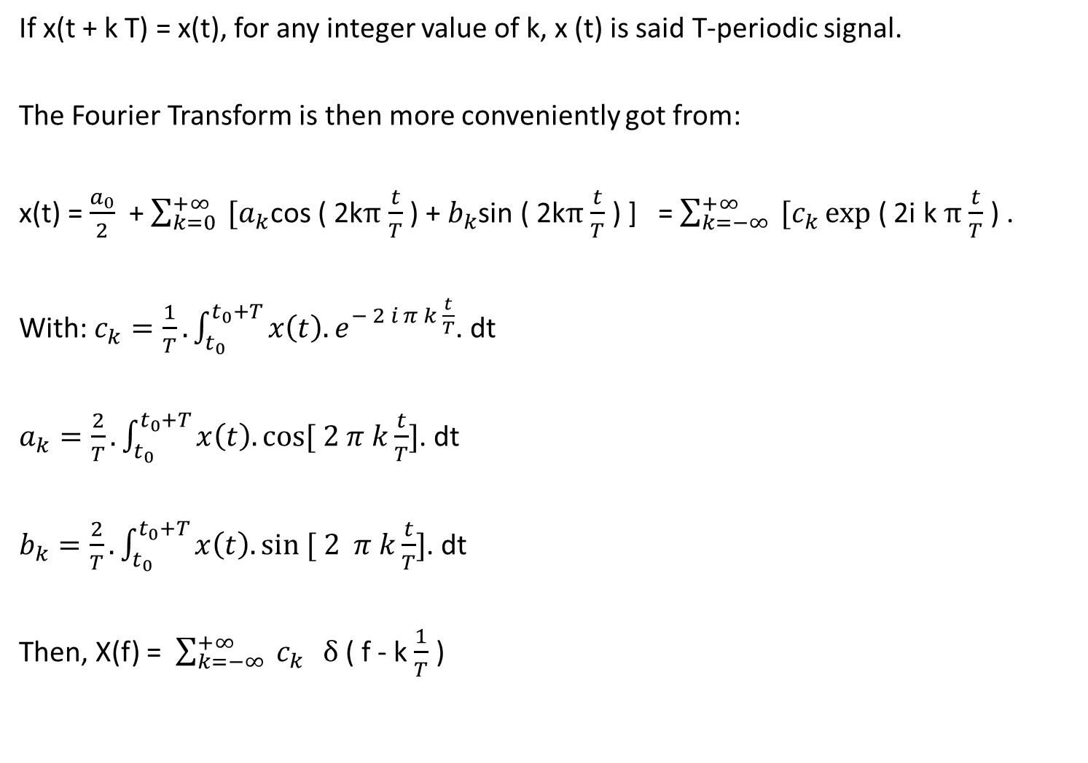
And for periodic signals ?
If x(t + k T) = x(t), for any integer value of k, x (t) is said T-periodic signal.
The Fourier Transform is then more conveniently got from:
x(t) = $\frac{a_{0}}{2}$ + $\sum_{k=0}^{+∞}{ [a_{k}}$cos ( 2kπ $\frac{t}{T}$ ) + $b_{k}$sin ( 2kπ $\frac{t}{T}$ ) ] = $\sum_{k=−∞}^{+∞}{ [c_{k}}exp$ ( 2i k π $\frac{t}{T}$ ) .
With: $c_{k}=\frac{1}{T}. \int_{t_{0}}^{t_{0}+T}{x\left(t\right). e^{− 2 i π k \frac{t}{T}}}$. dt
$a_{k}=\frac{2}{T}. \int_{t_{0}}^{t_{0}+T}{x\left(t\right). cos⁡[ 2 π k\frac{t}{T}]}$. dt
$b_{k}=\frac{2}{T}. \int_{t_{0}}^{t_{0}+T}{x\left(t\right). sin ⁡[ 2 π k\frac{t}{T}]}$. dt
Then, X(f) = $\sum_{k=−∞}^{+∞}{ c_{k}} δ$ ( f - k $\frac{1}{T}$ )

Slide 18
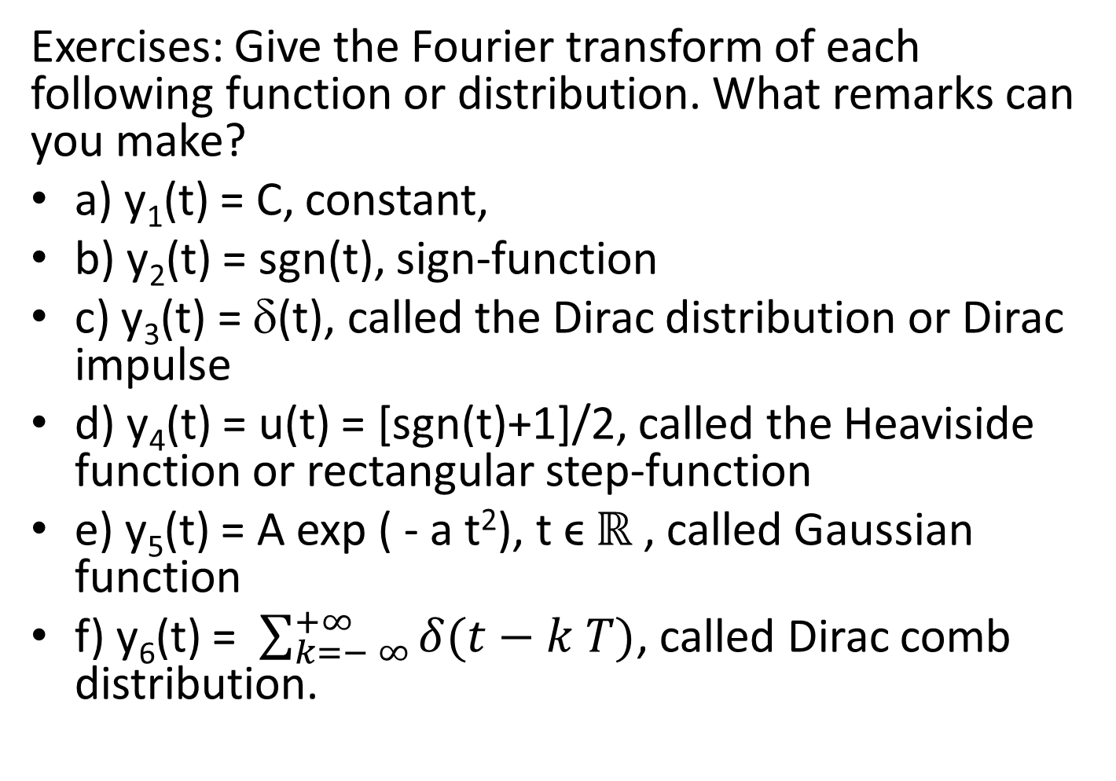
Exercises: Give the Fourier transform of each following function or distribution. What remarks can you make?
a) y₁(t) = C, constant,
b) y₂(t) = sgn(t), sign-function
c) y₃(t) = δ(t), called the Dirac distribution or Dirac impulse
d) y₄(t) = u(t) = [sgn(t)+1]/2, called the Heaviside function or rectangular step-function
e) y₅(t) = A exp ( - a t²), t ϵ ℝ , called Gaussian function
f) y₆(t) = $\sum_{k=− ∞}^{+∞}{δ(t−k T)}$, called Dirac comb distribution.

Slide 19
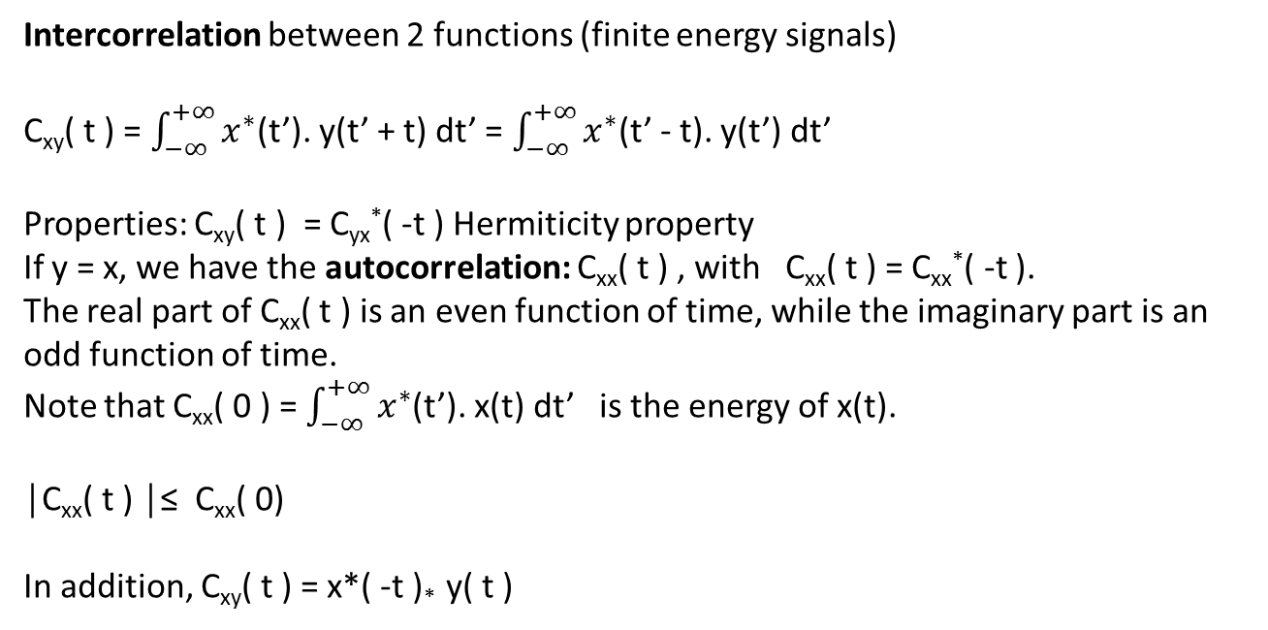
Intercorrelation between 2 functions (finite energy signals)
C_{xy}( t ) = $\int_{−∞}^{+∞}{x^{∗}}$(t’). y(t’ + t) dt’ = $\int_{−∞}^{+∞}{x^{∗}}$(t’ - t). y(t’) dt’
Properties: C_{xy}( t ) = C_{yx}*( -t ) Hermiticity property
If y = x, we have the autocorrelation: C_{xx}( t ) , with C_{xx}( t ) = C_{xx}*( -t ).
The real part of C_{xx}( t ) is an even function of time, while the imaginary part is an odd function of time.
Note that C_{xx}( 0 ) = $\int_{−∞}^{+∞}{x^{∗}}$(t’). x(t) dt’ is the energy of x(t).
│C_{xx}( t ) │≤ C_{xx}( 0)
In addition, C_{xy}( t ) = x*( -t )* y( t )
Plancherel’s Theorem
F [ f * g ] = F [ f ] . F [ g ]
And F [ f . g ] = F [ f ] * F [ g ]

Slide 20
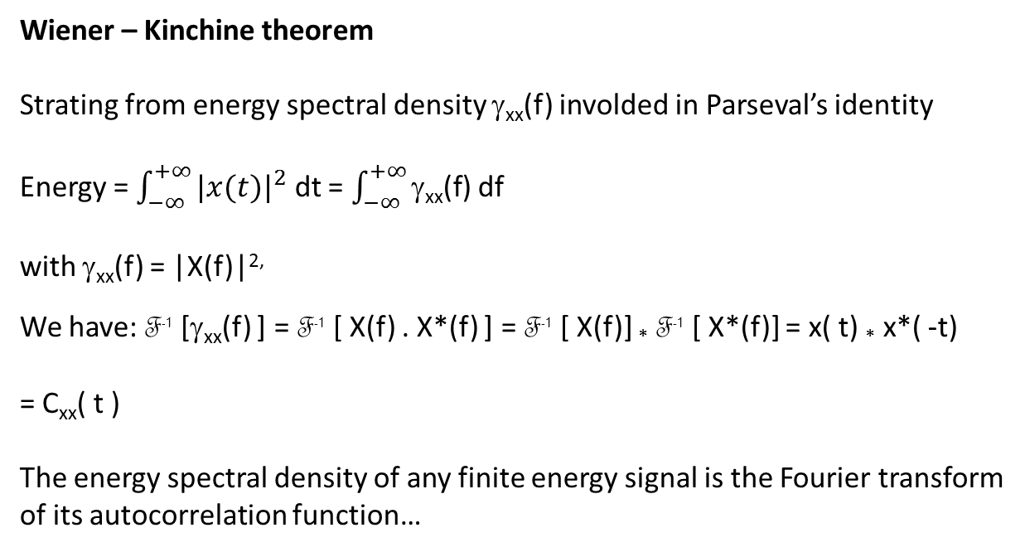
Wiener – Kinchine theorem
Strating from energy spectral density γ_{xx}(f) involded in Parseval’s identity
Energy = $\int_{−∞}^{+∞}{{|x(t)|}^{2}}$ dt = $\int_{−∞}^{+∞}{\text{g}\text{xx}\text{(}\text{f}\text{)}}$ df
with γ_{xx}(f) = |X(f)|^{2,}
We have: F⁻¹ [γ_{xx}(f) ] = F⁻¹ [ X(f) . X*(f) ] = F⁻¹ [ X(f)] * F⁻¹ [ X*(f)] = x( t) * x*( -t)
= C_{xx}( t )
The energy spectral density of any finite energy signal is the Fourier transform of its autocorrelation function…

Slide 21
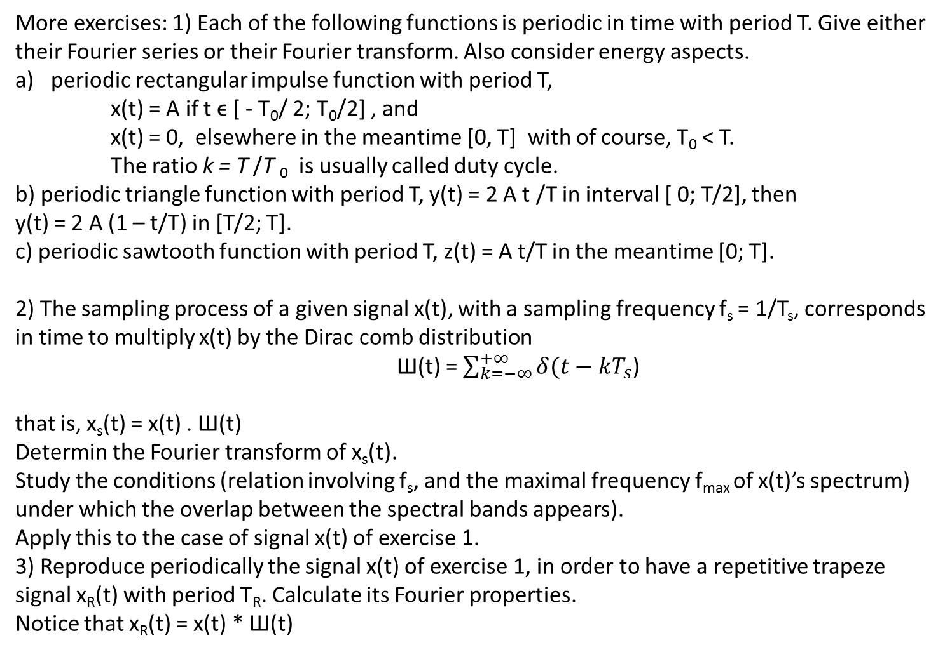
More exercises: 1) Each of the following functions is periodic in time with period T. Give either their Fourier series or their Fourier transform. Also consider energy aspects.
periodic rectangular impulse function with period T,
x(t) = A if t ϵ [ - T₀/ 2; T₀/2] , and
x(t) = 0, elsewhere in the meantime [0, T] with of course, T₀ < T.
The ratio k = T /T ₀ is usually called duty cycle.
b) periodic triangle function with period T, y(t) = 2 A t /T in interval [ 0; T/2], then
y(t) = 2 A (1 – t/T) in [T/2; T].
c) periodic sawtooth function with period T, z(t) = A t/T in the meantime [0; T].
2) The sampling process of a given signal x(t), with a sampling frequency f_{s} = 1/T_{s}, corresponds in time to multiply x(t) by the Dirac comb distribution
Ш(t) = $\sum_{k=−∞}^{+∞}{δ(t−kT_{s}}$)
that is, x_{s}(t) = x(t) . Ш(t)
Determin the Fourier transform of x_{s}(t).
Study the conditions (relation involving f_{s}, and the maximal frequency f_{max} of x(t)’s spectrum)
under which the overlap between the spectral bands appears).
Apply this to the case of signal x(t) of exercise 1.
3) Reproduce periodically the signal x(t) of exercise 1, in order to have a repetitive trapeze
signal x_{R}(t) with period T_{R}. Calculate its Fourier properties.
Notice that x_{R}(t) = x(t) * Ш(t)

Slide 22
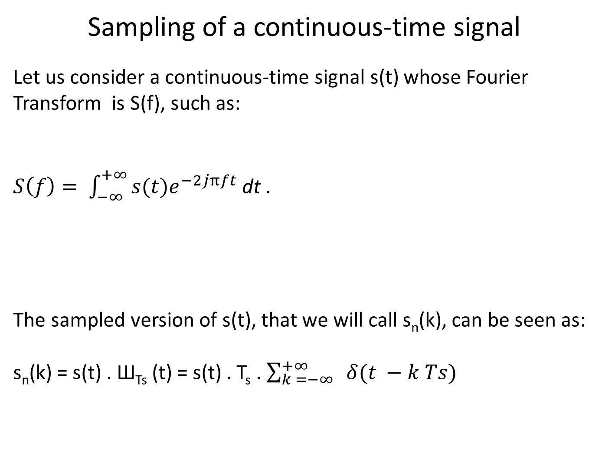
Sampling of a continuous-time signal
Let us consider a continuous-time signal s(t) whose Fourier Transform is S(f), such as:
$S\left(f\right)= \int_{−∞}^{+∞}{s(t)e^{−2jπft}}$ dt .
The sampled version of s(t), that we will call s_{n}(k), can be seen as:
s_{n}(k) = s(t) . Ш_{Ts} (t) = s(t) . T_{s} . $\sum_{k =−∞}^{+∞}{ δ(t −k Ts)}$

Slide 23
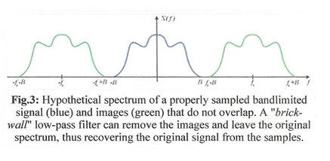
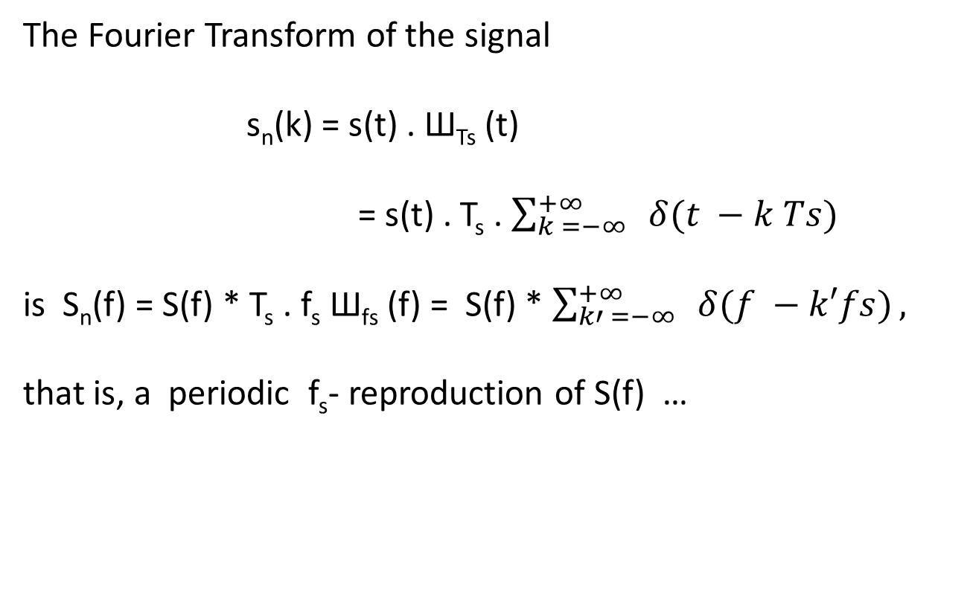
The Fourier Transform of the signal
s_{n}(k) = s(t) . Ш_{Ts} (t)
= s(t) . T_{s} . $\sum_{k =−∞}^{+∞}{ δ(t −k Ts)}$
is S_{n}(f) = S(f) * T_{s} . f_{s} Ш_{fs} (f) = S(f) * $\sum_{k′ =−∞}^{+∞}{ δ(f −k′fs)},$
that is, a periodic f_{s}- reproduction of S(f) …

Slide 24
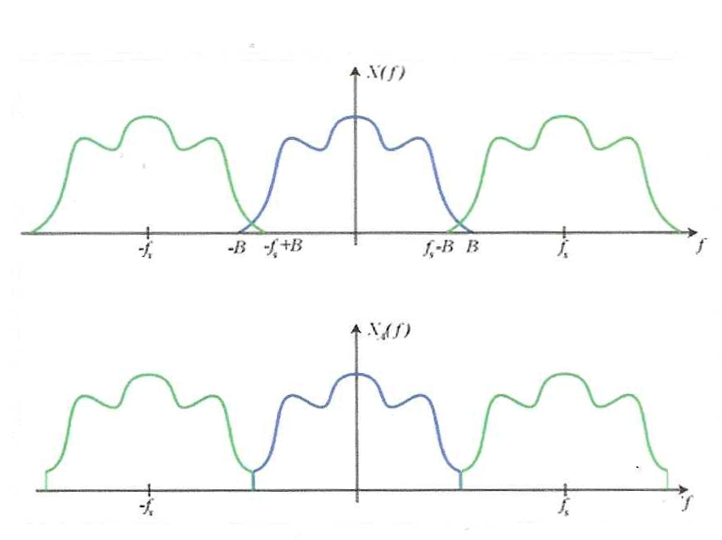
Fig. 2: badly sampled !!
Fig. 4: could be correctly sampled (strictly said), but dangereous in fact….

Slide 25
An other useful expression for S_{n}(f) comes from the definition of Fourier Transform:
Remember: G(f) = $\int_{−∞}^{+∞}{g\left(t\right) e^{−2jπft}dt }$ for any signal g(t),
Here for s_{n}(k), S_{n}(f) =
$\int_{−∞}^{+∞}{{\text{s}\text{(}\text{t}\text{) .}\text{T}\text{s}\text{ .}\sum_{n =−∞}^{+∞}{ δ(t −n Ts)}. e}^{−2jπft}dt }$
= T_{s} . $\sum_{n =−∞}^{+∞}{{\text{s}\text{(}\text{n}T_{s}\text{) }e}^{−2jπfnT_{s}}}$

Slide 26
To illustrate the necessity of a strict relation « greater than » between f_{s} and 2 f_{max}, let us consider two different sine functions :
s₁(t) = A cos (2 π f_{max} t + ϑ) = A cos (2 π f_{max} t ) . cos ( ϑ) – A sin (2 π f_{max} t ). sin ( ϑ).
s₂(t) = A cos (2 π f_{max} t ) . cos ( ϑ)
With f_{s} = 2 f_{max}, that is, T_{s} = 1/(2 f_{max}), the different samples are given by:
s₁(nTs) = A cos (π n). Cos ( ϑ) – sin (π n) . Sin ( ϑ) = A (-1)^{n} . cos ( ϑ)
s₂(nTs) = A cos (π n). Cos ( ϑ) = A (-1)^{n} . cos ( ϑ)
And therefore, the sampled signals cannot be recognized…
Other proof: a family of sine functions at the critical sampling frequency f_{s} = 2 f₀, all having the same sample sequence of alternating + 1 and – 1…
They are all aliases of each other, even though their frequency stays strictly inside the Shannon’s interval [0, f_{s}/2].

Slide 27
Thus, to correctly sample a continuous-time signal whose spectrum is limited by a maximum frequency f_{max}, it is required to take a sampling frequency much greater that twice the maximum frequency:
f_{s} >> 2 f_{max} ,
even if Shannon – Nyquist Theorem tells us only f_{s} ≥ 2 f_{max} !!!

Slide 28
That means that, even considering in the Fourier decomposition of the signal the sine component of frequency f = f_{max}, much more than 2 samples per period are to be taken.

Slide 29
Whittaker – Shannon interpolation formula
This formula allows to reconstruct, from a well-sampled signal, the good continuous-time (analog) signal.
Let us start from the sampled signal s_{n}(k) = s(t) . T_{s} . $\sum_{k =−∞}^{+∞}{ δ(t −k Ts)}$,
whose Fourier Transform is:
S_{n}(f) = S(f) * Ш_{fs} (f) = S(f) * $\sum_{k′ =−∞}^{+∞}{ δ(f −k′fs)}\text{= }\text{Ts}\text{ . }\sum_{n =−∞}^{+∞}{{\text{s}\text{(}\text{n}T_{s}\text{) }e}^{−2jπfnT_{s}}}.$
This signal is now applied at the input of a rectangular low-pass filter of bandwidth f_{s}/2, with a transfer function H(f) = rect [f/f_{s}], such as:
rect [f/f_{s}] = 1 if f ϵ [ -f_{s}/2 , + f_{s}/2 ]
rect [f/f_{s}] = 0 elsewhere.
At the output of the filter, we get a signal r(t) whose Fourier Transform is:
R(f) = rect [f/f_{s}] . S_{n}(f) = rect [f/f_{s}] . T_{s} . $\sum_{n =−∞}^{+∞}{{\text{s}\text{(}\text{n}T_{s}\text{) }e}^{−2jπfnT_{s}}}$

Slide 30
Taking now the Inverse Fourier Transform of R(f):
r(t) = F⁻¹[ R(f)]= F⁻¹{T_{s} . rect [f/f_{s}] . $\sum_{n =−∞}^{+∞}{{\text{s}\text{(}\text{n}T_{s}\text{) }e}^{−2jπfnT_{s}}}\}$
yields:
r(t) = T_{s} $. \sum_{n =−∞}^{+∞}{\text{s}\text{(}\text{n}T_{s}\text{)}}$. F⁻¹{rect [f/f_{s}]. $e^{−2jπfnT_{s}}$}
r(t) = $\sum_{n =−∞}^{+∞}{\text{s}\text{(}\text{n}T_{s}\text{)}}$. sinc [ $\frac{t − n T_{s}}{T_{s}}$ ] → s(t)
This shows explicitely how the samples s(nT_{s}) can be recombined to reconstruct s(t).

Slide 31
Larger than necessary values of f_{s} (smaller values of T_{s}) , called oversampling, have no effect on the outcome of the reconstruction and have the benefit of leaving place for a transition band where H(f) is free to take intermediate values.
Undersampling, which causes aliasing, is not in general a reversible operation and the informatioin is definitively lost.

Slide 32
If, practically, for a fixed sampling frequency f_{s}, we are not sure that the input signal has all its frequency inside the interval [0, f_{s}/2], we have to use an anti-aliasing low-pass analog filter before the sampling block in the signal processing chain.
Analog signal
Analog signal
Continuous- time amplifier
Low-pass filter
f_{c} ≤ f_{s}/2
sensor
Sampled signal
Analog signal
Analog to Digital Converter ADC
Quantizier

Slide 33
Quantization
Temporal sampling yields x(kT_{s}), that is, a series of samples taking continuous amplitudes with an infinite number of values.
t = k T, where k ϵ Z → x(kTs) = x(k) ϵ R or C.
Actually, two different values of x(kT_{s}) are only discernable if their difference is greater than a specific value q (or equal to q ). This number q is called the quantization step.
Quantization is an approximating process, consisting in replacing any value for x(kT_{s}) by a multiple of q.
t = k T, where k ϵ Z → x(kTs) = x(k) = n . q, where n ϵ Z.

Slide 34
There exist two different methods to quantize a signal x(k) into n . q
1) Truncated number method
If x(k) ϵ [ n . q ; ( n + 1 ) . q [ , x(k) is replaced by n . q
x_{q}(t)
3q
2q
q
-q
x(t)
q
2q
3q
4q
-q

Slide 35
2) Rounded number method
if x(k) ϵ ] ( n - ½ ). q ; ( n + ½) . q ] , x(k) is replaced by n. q
x_{q}(t)
3q
2q
q
-q
x(t)
q
2q
3q
4q
-q

Slide 36
Quantization noise:
The result of this quantization is to superpose to the original signal an error signal, called « quantization noise »:
e(t) = x(t) – x_{q}(t) or x(t) = x_{q}(t) + e(t)
x(t)
e(t)
3q
2q
q
t
In Truncature Quantization, the error is such that 0 ≤ e(t) ≤ q

Slide 37
x(t)
e(t)
3q
2q
q
In Rounded Number Quantization, the error is such that - q/2 ≤ e(t) ≤ + q/2

Slide 38
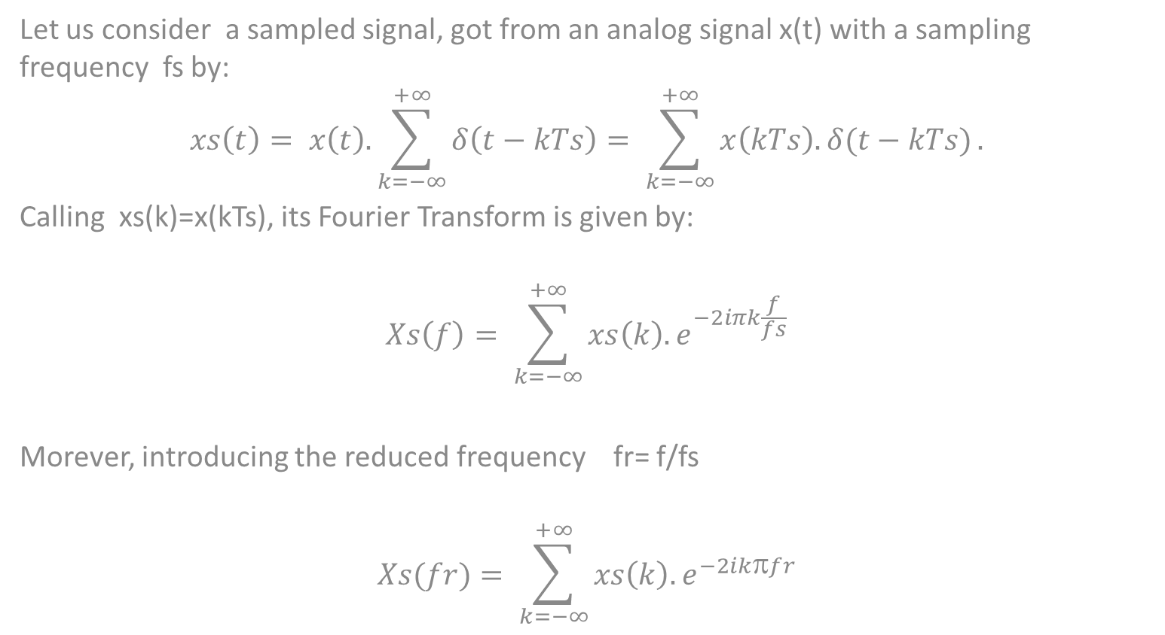
Fourier Transform of a discrete signal
Let us consider a sampled signal, got from an analog signal x(t) with a sampling frequency fs by:
$$xs\left(t\right)= x\left(t\right).\sum_{k=−∞}^{+∞}{δ\left(t−kTs\right)= \sum_{k=−∞}^{+∞}{x\left(kTs\right).δ(t−kTs)}}.$$
Calling xs(k)=x(kTs), its Fourier Transform is given by:
$$Xs\left(f\right)= \sum_{k=−∞}^{+∞}{xs\left(k\right).e^{−2iπk\frac{f}{fs}}}$$
Morever, introducing the reduced frequency fr= f/fs
$$Xs(fr)= \sum_{k=−∞}^{+∞}{xs\left(k\right).e^{−2ik\text{p}fr}}$$

Slide 39
This Fourier transform is very useful, because it decomposes the discrete signal into an orthogonal basis of complex trigonometric functions. Note that if x(t) is real, Xs*(fr)=Xs(-fr) The modulus is even: I Xs(fr)I = IXs(-fr)I The phasis is odd: ϕ(-fr) = − ϕ(fr). Xs(fr) is periodic in fr, with a period of 1: Xs(fr + 1) = Xs(fr). It is thus enough to study Xs(fr) in [ -1/2; +1/2];

Slide 40
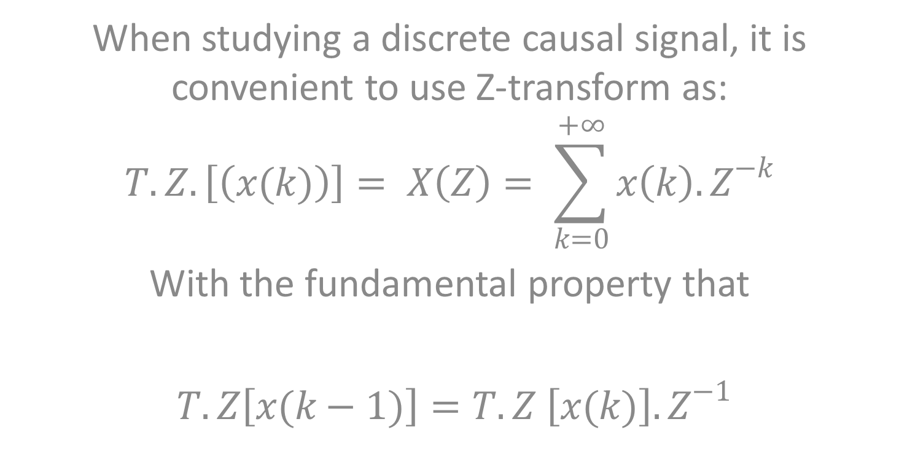
Z-Transform of a discrete causal signal
When studying a discrete causal signal, it is convenient to use Z-transform as:
$$T.Z.\left[\left(x(k)\right)\right]= X\left(Z\right)= \sum_{k=0}^{+∞}{x\left(k\right). Z^{−k}}$$
With the fundamental property that
$T.Z\left[x(k−1)\right]=T.Z \left[x(k)\right].Z^{−1}$

Slide 41
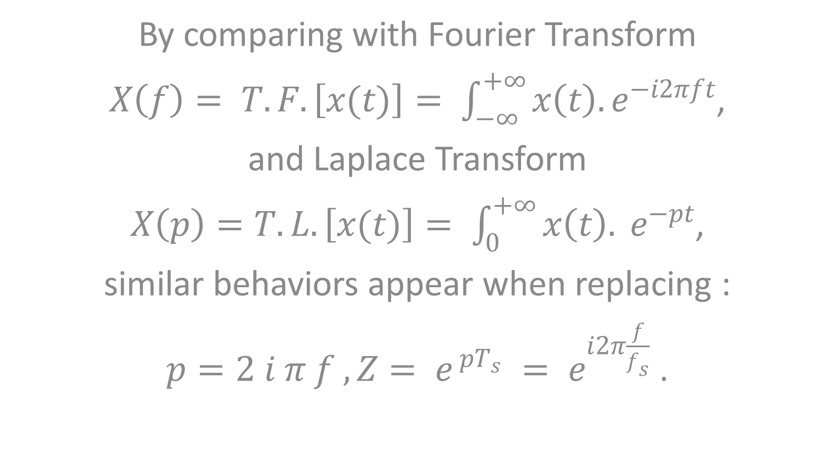
Relations between Fourier Transform, Laplace Transform and Z-Transform
By comparing with Fourier Transform
$X\left(f\right)= T.F.\left[x(t)\right]= \int_{−∞}^{+∞}{x\left(t\right). e^{−i2πft}}$,
and Laplace Transform
$X\left(p\right)=T.L. \left[x(t)\right]= \int_{0}^{+∞}{x\left(t\right). e^{−pt}}$,
similar behaviors appear when replacing :
$p=2 i π f , Z= e^{ pT_{s}} = e^{i2π\frac{f}{f_{s}}}$ .

Slide 42
DISCRETE FOURIER TRANSFORM
In Mathematics, the Discrete Fourier Transform (DFT) is a specific kind of discrete transform. It transforms a function into another, which is called the frequency domain representation, or simply the DFT, of the original function (which is a function in the time domain).
But the DFT requires an input function that is discrete and whose non-zero values have a finite duration. Such inputs are for example created by sampling a continuous function, like a person's voice

Slide 43
The DFT only evaluates enough frequency components to reconstruct the finite segment that was analyzed. Using the DFT implies that the finite segment that is analyzed is:
A finite duration signal
Or one period of an infinitely extended periodic signal.
if this is not actually true, a window function has to be used to reduce the artifacts in the spectrum and the inverse DFT cannot reproduce the entire time domain.
Therefore it is often said that the DFT is a transform for Fourier analysis of finite-domain discrete-time functions.

Slide 44
The input to the DFT is a finite sequence of real or complex numbers making the DFT ideal for processing information stored in computers. In particular, the DFT is widely employed in signal processing to analyze the frequencies contained in a sampled signal, to solve partial differential equations (PDE), and to perform other operations such as convolutions.... A key enabling factor for these applications is the fact that the DFT can be computed efficiently in practice using a Fast Fourier Transform (FFT) algorithm. FFT algorithms are so commonly employed to compute DFTs that the term "FFT" is often used to mean "DFT" in colloquial settings. Formally, there is a clear distinction: "DFT" refers to a mathematical transformation or function, regardless of how it is computed, whereas "FFT" refers to a specific family of algorithms for computing DFTs.

Slide 45
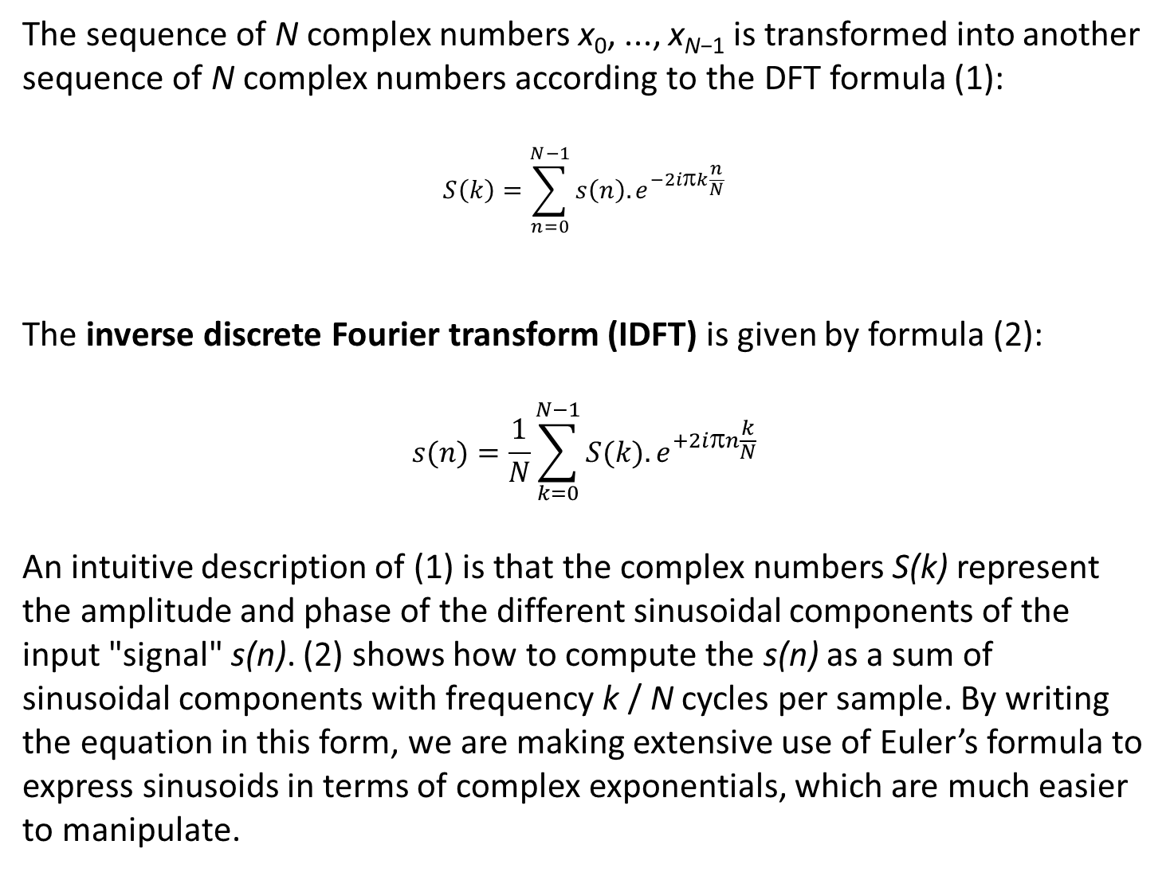
The sequence of N complex numbers x₀, ..., x_{N−1} is transformed into another sequence of N complex numbers according to the DFT formula (1): $$S\left(k\right)=\sum_{n=0}^{N−1}{s\left(n\right).e^{−2i\text{p}k\frac{n}{N}}}$$ The inverse discrete Fourier transform (IDFT) is given by formula (2): $$s(n)=\frac{1}{N}\sum_{k=0}^{N−1}{S(k).e^{+2i\text{p}n\frac{k}{N}}}$$ An intuitive description of (1) is that the complex numbers S(k) represent the amplitude and phase of the different sinusoidal components of the input "signal" s(n). (2) shows how to compute the s(n) as a sum of sinusoidal components with frequency k / N cycles per sample. By writing the equation in this form, we are making extensive use of Euler’s formula to express sinusoids in terms of complex exponentials, which are much easier to manipulate.

Slide 46
Note that the normalization factor multiplying the DFT and IDFT (here 1 and 1/N) and the signs of the exponents are merely conventions, and differ in some treatments. The only requirements of these conventions are that the DFT and IDFT have opposite-sign exponents and that the product of their normalization factors be 1/N. A normalization of $\frac{1}{\sqrt{N}}$ for both the DFT and IDFT makes the transforms unitary, which has some theoretical advantages, but it is often more practical in numerical computation to perform the scaling all at once as above (and a unit scaling can be convenient in other ways). (The convention of a negative sign in the exponent is often convenient because it means that S(k) is the amplitude of a "positive frequency" 2πk / N. )

Slide 47
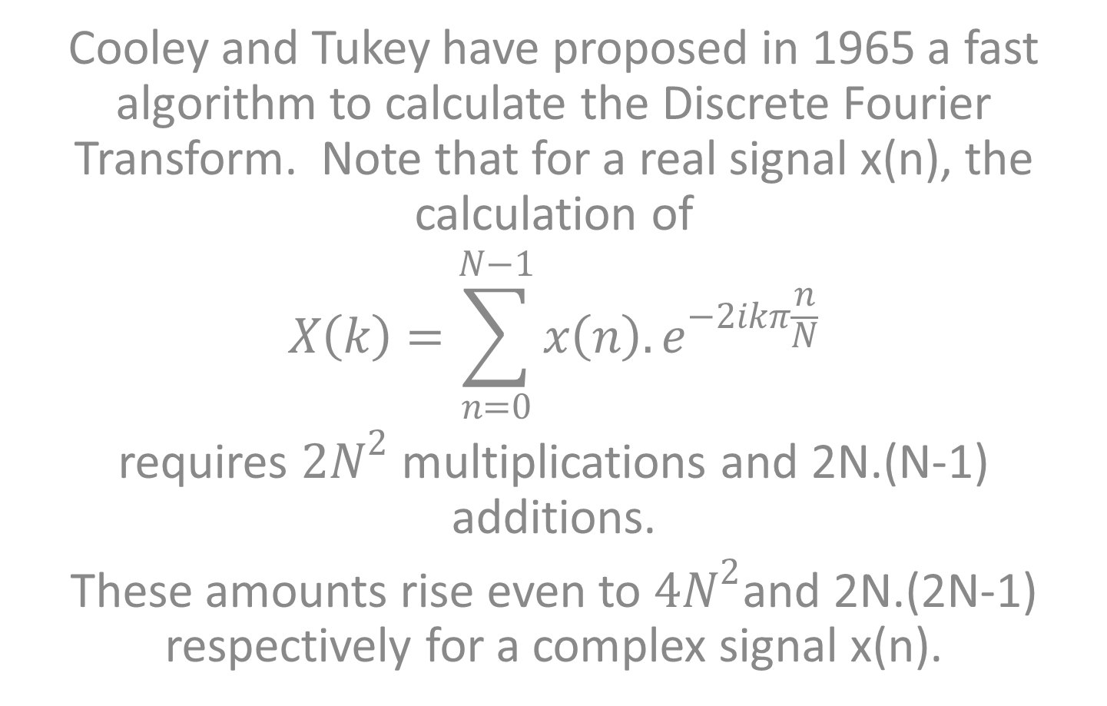
Fast Fourier Transform
Cooley and Tukey have proposed in 1965 a fast algorithm to calculate the Discrete Fourier Transform. Note that for a real signal x(n), the calculation of
$$X\left(k\right)=\sum_{n=0}^{N−1}{x\left(n\right).e^{−2ikπ\frac{n}{N}}}$$
requires $2N^{2}$ multiplications and 2N.(N-1) additions.
These amounts rise even to $4N^{2}$and 2N.(2N-1) respectively for a complex signal x(n).

Slide 48
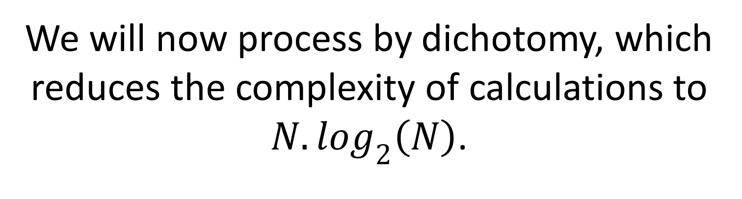
We will now process by dichotomy, which reduces the complexity of calculations to $N. \log_{2}\left(N\right)$.
Let us introduce first the Twiddle factor as
$$W_{N}=exp\left(− i \frac{2π}{N}\right), and take an example with N=8.$$
We get for the vector X(k) …

Slide 49
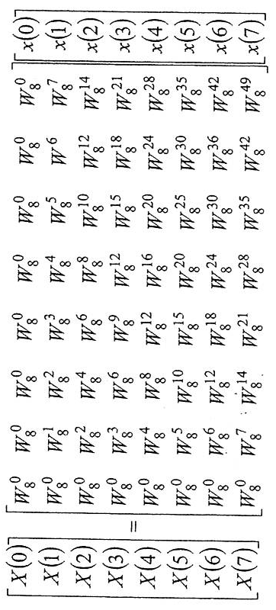
8

Slide 50
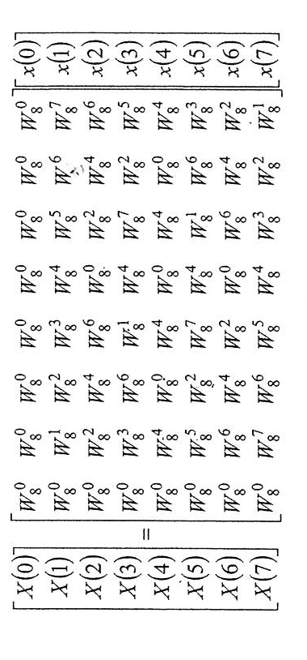
With standard properties on complex numbers, such as
$W_{N}^{N}={\left[exp\left(− i \frac{2π}{N}\right)\right]}^{kN}= 1$ , $W_{N}^{N/2}={\left[exp\left(− i \frac{2π}{N}\right)\right]}^{N/2}= −1 or W_{N}^{N+k}= W_{N}^{k}$
we then simplify the matrix as:
8

Slide 51
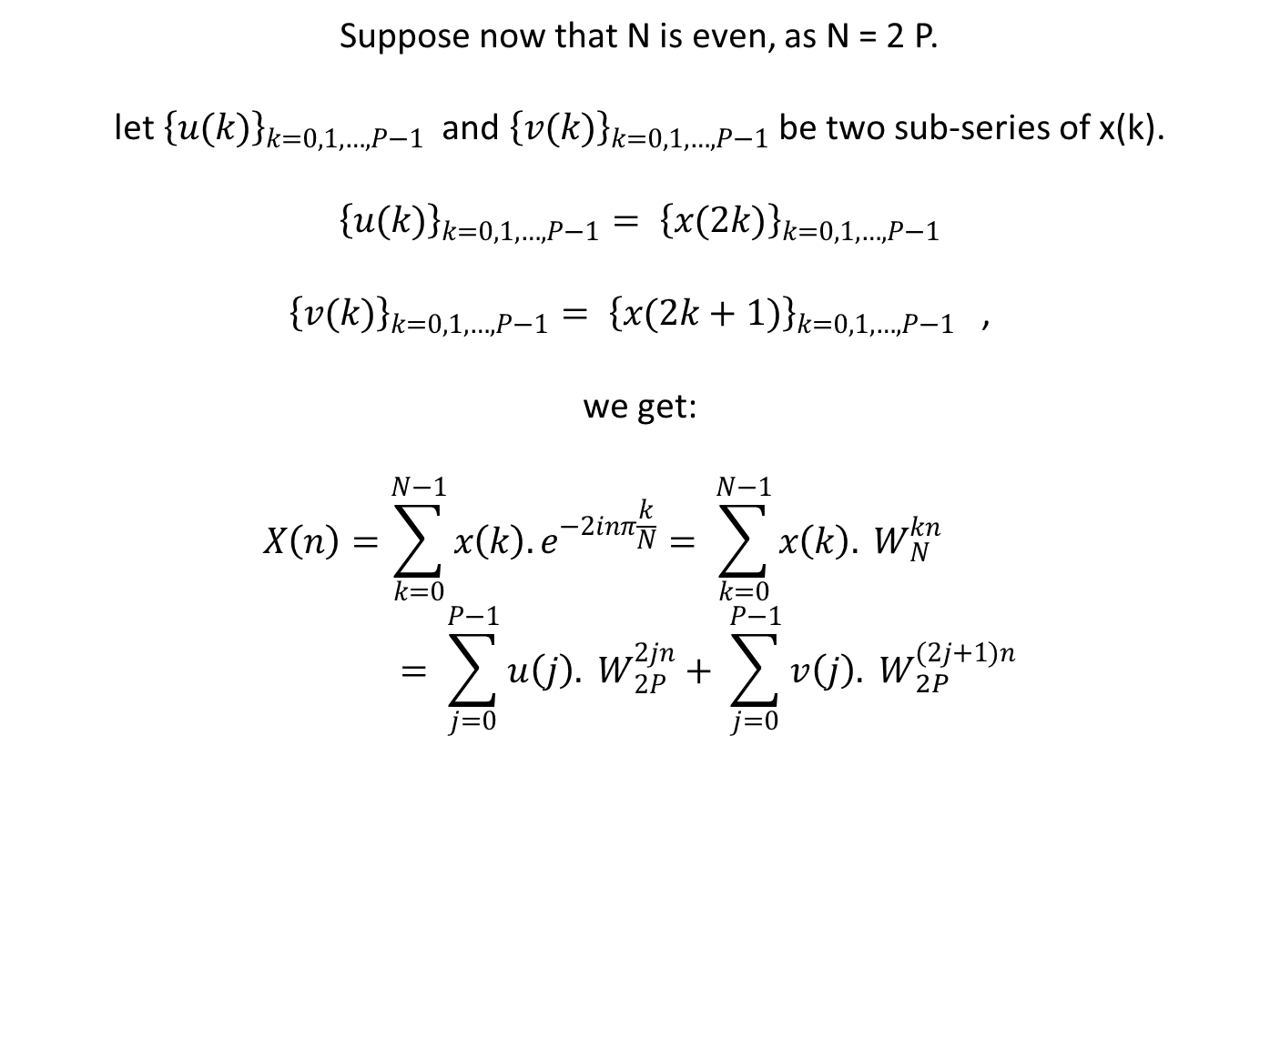
Suppose now that N is even, as N = 2 P. let ${\left\{u(k)\right\}}_{k=0,1,…, P−1}$ and ${\left\{v(k)\right\}}_{k=0,1,…, P−1}$ be two sub-series of x(k). $${\left\{u(k)\right\}}_{k=0,1,…, P−1}= {\left\{x(2k)\right\}}_{k=0,1,…, P−1}$$ ${\left\{v(k)\right\}}_{k=0,1,…, P−1}= {\left\{x(2k+1)\right\}}_{k=0,1,…, P−1}$ , we get: $$X\left(n\right)=\sum_{k=0}^{N−1}{x\left(k\right).e^{−2inπ\frac{k}{N}}}= \sum_{k=0}^{N−1}{x\left(k\right). }W_{N}^{kn}= \sum_{j=0}^{P−1}{u\left(j\right). }W_{2P}^{2jn}+ \sum_{j=0}^{P−1}{v\left(j\right). }W_{2P}^{(2j+1)n}$$

Slide 52
X(n) = $$\sum_{j=0}^{P−1}{u\left(j\right). }W_{P}^{jn}+W_{N}^{n} \sum_{j=0}^{P−1}{v\left(j\right). }W_{P}^{jn}= U\left(n\right)+ W_{N}^{n}. V\left(n\right)$$ Thus, the calculations are made on P points instead of N = 2 P points…. In addition, X(n+P) $= U\left(n\right)− W_{N}^{n}. V\left(n\right)$

Slide 53
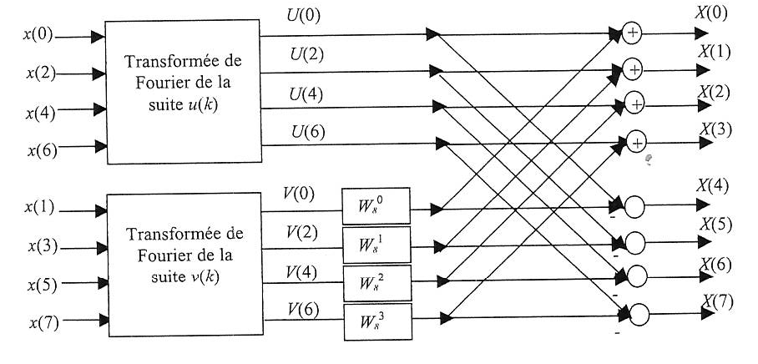
u(k) serie’s Fourier Transform
U(1)
U(2)
U(3)
v(k) serie’s Fourier Transform
V(1)
V(2)
V(3)

Slide 54
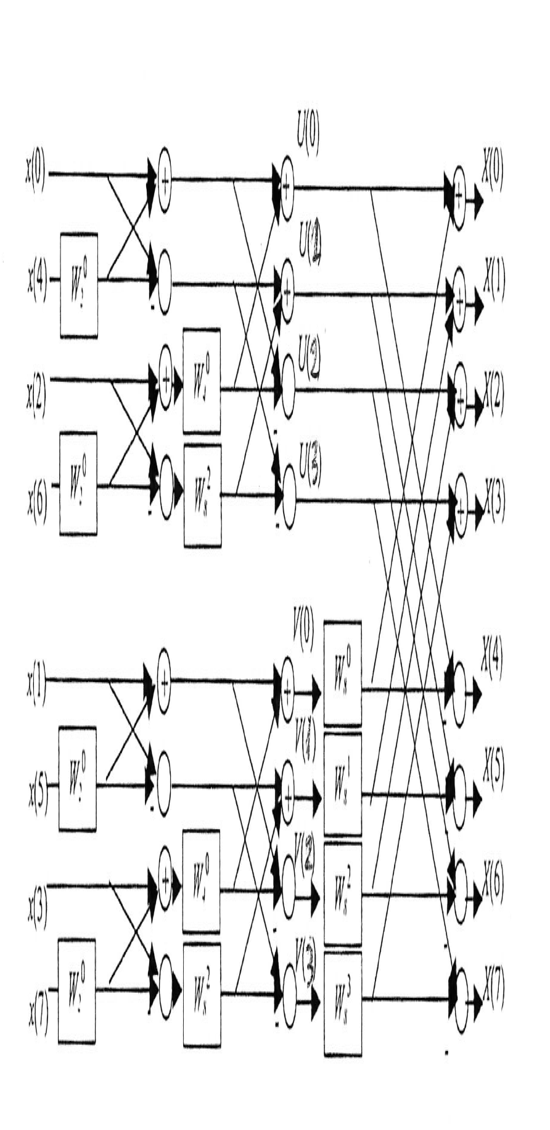

Slide 55
Exercise:
Second part of the terminal exam: December 2010
Give the “butterfly wings” diagram allowing to calculate the Fast Fourier Transform X(n) of the discrete signal x(k) when the total number of samples is N=4, for the time and for the spectrum. The waited diagram should hold the 4 coefficients x(k) at the left part and the 4 coefficient X(n) at the right part and should profit from the symmetry in calculations. Specifically, call W₄ the twiddle factor. Count the total number of operators as additions/subtractions and multiplications.

Slide 56
Other exercises
Show that the different powers of theTwiddle factor can be computed recursively by the property:
${W_{N}}_{}^{qn}$ = ${W_{N}}_{}^{q(n−1)}$. ${W_{N}}_{}^{q}$
Perform this computation once using single-precision floating-point arithmetic and once using only 4 significant digits. Note the deterioration due to the accumulation of round-off errors in the later case.
Show then how the previous results can be improved by resetting the result to the correct value –j, each time when qn = N/4.

Slide 57
Correlation of discrete-time signals
A mathematical operation, close to convolution product, is correlation. Here, the goal is to measure the degree to which two signals are similar and to extract some relevant information related to this similarity.
A specific axample is given by radars. Let x(n) be the sampled version of the transmitted signal and y(n) the sampled version of the received (after reflection on the target) one. This later signal will be composed of a delayed version of x(n) with attenuation a and corrupted by w(n), that is an additive noise signal and other interference inherent in communication system:
y(n) = a. x(n – D) + w(n).
Assuming that the delay is a multiple of the sampling time T_{s}, the round-trip delay D is to be evaluated as an integer.
The crosscorrelation sequence will lead to the evaluation of D.

Slide 58
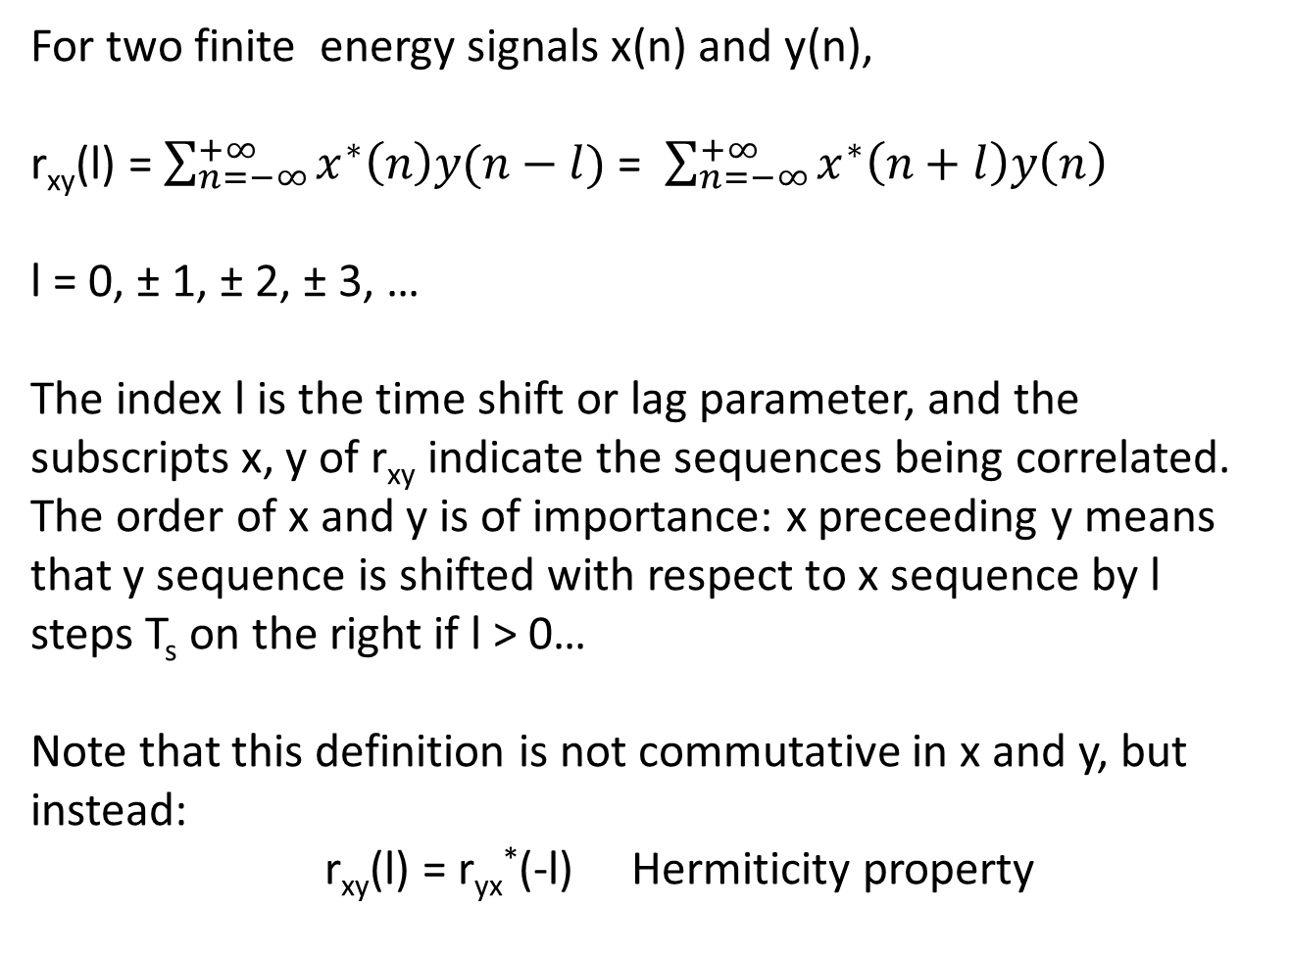
For two finite energy signals x(n) and y(n),
r_{xy}(l) = $\sum_{n=−∞}^{+∞}{x^{∗}\left(n\right)y(n−l)}$ = $\sum_{n=−∞}^{+∞}{x^{∗}\left(n+l\right)y\left(n\right) }$
l = 0, ± 1, ± 2, ± 3, …
The index l is the time shift or lag parameter, and the subscripts x, y of r_{xy} indicate the sequences being correlated. The order of x and y is of importance: x preceeding y means that y sequence is shifted with respect to x sequence by l steps T_{s} on the right if l > 0…
Note that this definition is not commutative in x and y, but instead:
r_{xy}(l) = r_{yx}*(-l) Hermiticity property

Slide 59
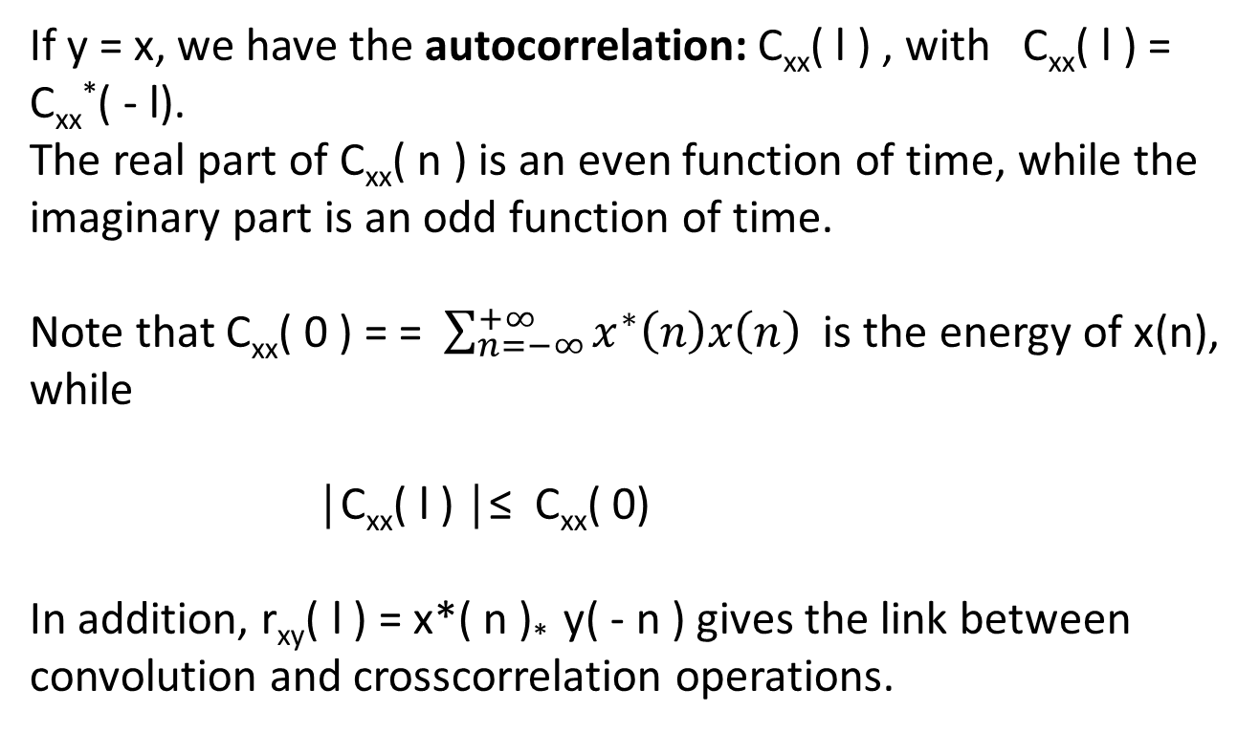
If y = x, we have the autocorrelation: C_{xx}( l ) , with C_{xx}( l ) = C_{xx}*( - l).
The real part of C_{xx}( n ) is an even function of time, while the imaginary part is an odd function of time.
Note that C_{xx}( 0 ) = = $\sum_{n=−∞}^{+∞}{x^{∗}\left(n\right)x\left(n\right) }$ is the energy of x(n), while
│C_{xx}( l ) │≤ C_{xx}( 0)
In addition, r_{xy}( l ) = x*( n )* y( - n ) gives the link between convolution and crosscorrelation operations.

Slide 60
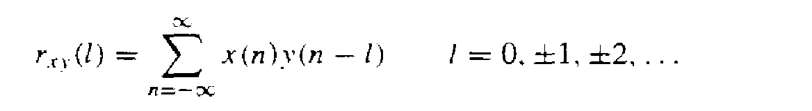
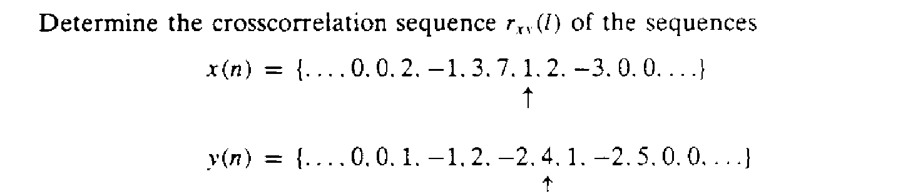
Exercise:
With the definition of crosscorrelation of x and y,
r_{xy}(l) = { …, 0, 0, 10, -9, 19, 36, -14, 33, 0, 7, 13, -18, 16, -7,5, -3, 0, 0, … }

Slide 61
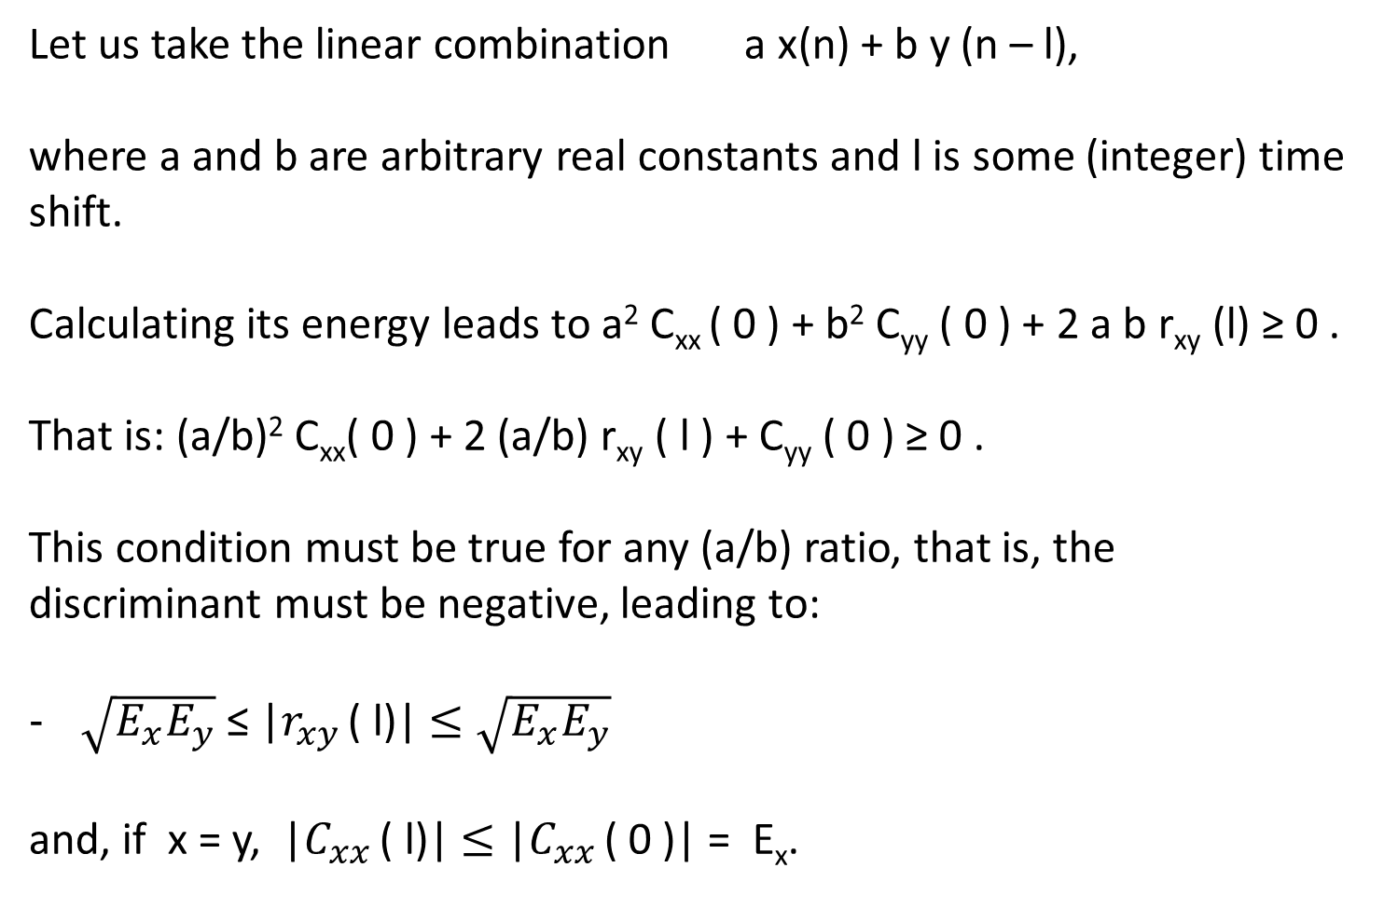
Let us take the linear combination a x(n) + b y (n – l),
where a and b are arbitrary real constants and l is some (integer) time shift.
Calculating its energy leads to a² C_{xx} ( 0 ) + b² C_{yy} ( 0 ) + 2 a b r_{xy} (l) ≥ 0 .
That is: (a/b)² C_{xx}( 0 ) + 2 (a/b) r_{xy} ( l ) + C_{yy} ( 0 ) ≥ 0 .
This condition must be true for any (a/b) ratio, that is, the discriminant must be negative, leading to:
$\sqrt{E_{x}E_{y}}$ ≤ |$r_{xy }$( l)| $≤\sqrt{E_{x}E_{y}}$
and, if x = y, |$C_{xx }$( l)| $≤$ |$C_{xx }$( 0 )| = E_{x}.

Slide 62
Characterization of discrete-time random signals,
as for example got from a uniformly sampling of a continuous-time random process X(t).
(Think on the air temperature in different cities around the world. For each city, there is a corresponding waveform that is a function of time. The set of all possible waveforms is called an ensemble of time functions or, equivalently, a random process. The waveform for the temperature in any particular city is a single realization or a sample function of the random process.)

Slide 63
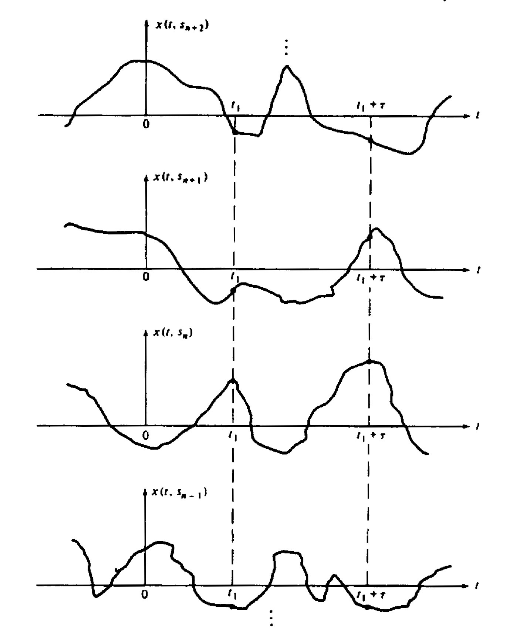
New-York
Beijing
Calcutta
Yaoundé

Slide 64
A discrete-time random process X(n) consists thus of an ensemble of sample sequences x(n). The statistical properties of X(n) are now studied, with the restriction that n is an integer time variable.
Note that for random processes, as for periodic signals, one cannot any more speak of finite energy signals, but instead of finite mean power signals, or more simply: power signals.
Some definitions would be slightly affected, …

Slide 65
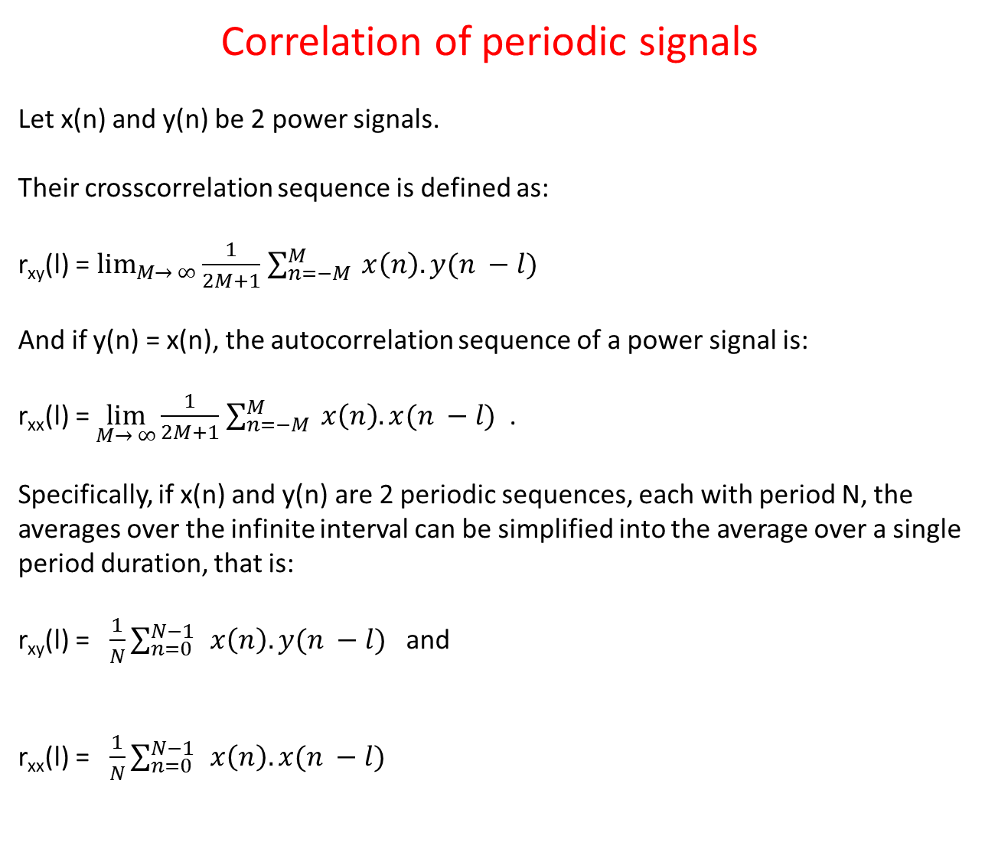
Correlation of periodic signals
Let x(n) and y(n) be 2 power signals.
Their crosscorrelation sequence is defined as:
r_{xy}(l) = $\lim_{M→ ∞}{\frac{1}{2M+1}}$ $\sum_{n=−M}^{M}{ x\left(n\right). y(n −l)}$
And if y(n) = x(n), the autocorrelation sequence of a power signal is:
r_{xx}(l) = $\lim_{M→ ∞}{\frac{1}{2M+1}}$ $\sum_{n=−M}^{M}{ x\left(n\right). x(n −l)}$ .
Specifically, if x(n) and y(n) are 2 periodic sequences, each with period N, the averages over the infinite interval can be simplified into the average over a single period duration, that is:
r_{xy}(l) = $\frac{1}{N}\sum_{n=0}^{N−1 }{ x\left(n\right). y(n −l)}$ and
r_{xx}(l) = $\frac{1}{N}\sum_{n=0}^{N−1 }{ x\left(n\right). x(n −l)}$

Slide 66
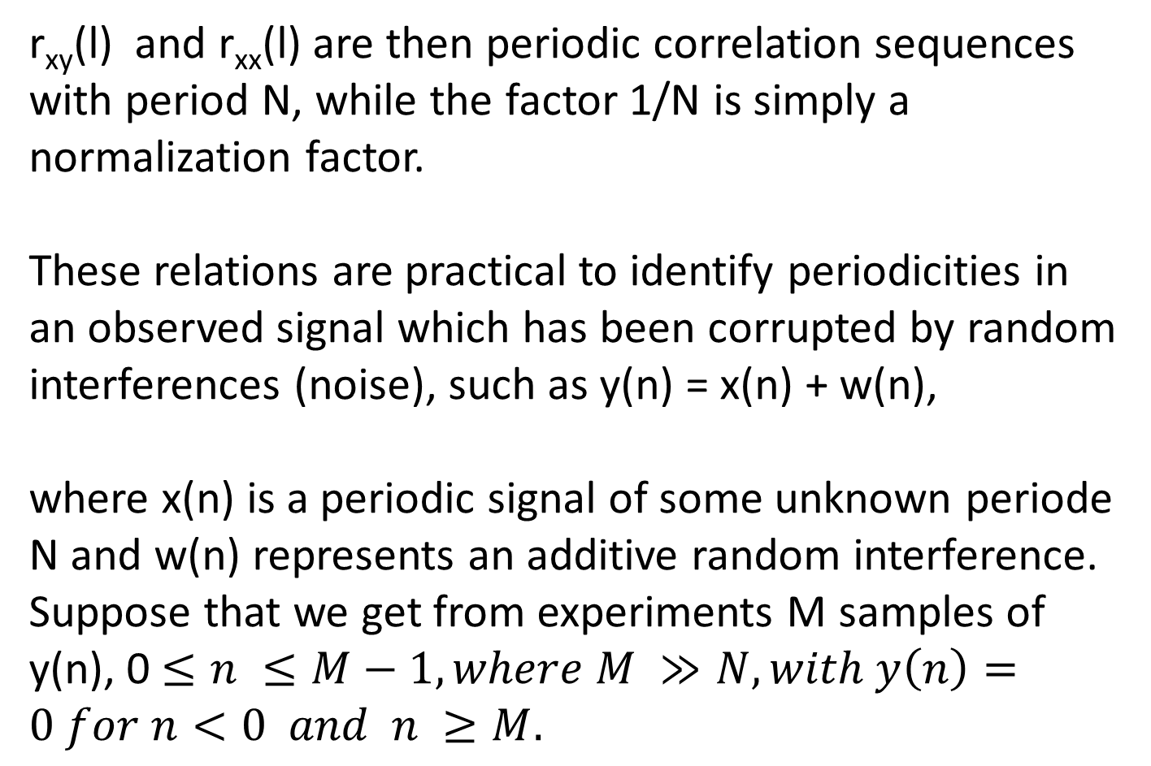
r_{xy}(l) and r_{xx}(l) are then periodic correlation sequences with period N, while the factor 1/N is simply a normalization factor.
These relations are practical to identify periodicities in an observed signal which has been corrupted by random interferences (noise), such as y(n) = x(n) + w(n),
where x(n) is a periodic signal of some unknown periode N and w(n) represents an additive random interference.
Suppose that we get from experiments M samples of y(n), 0 $≤n ≤M−1, where M ≫N, with y\left(n\right)=0 for n<0 and n ≥M.$

Slide 67
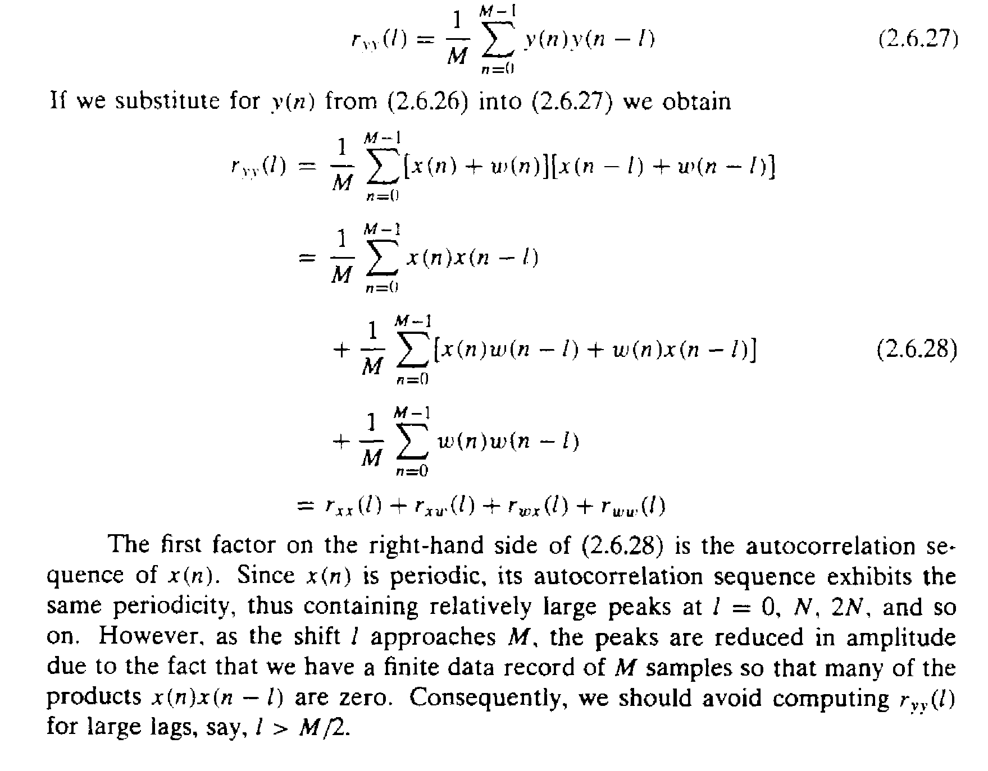

Slide 68
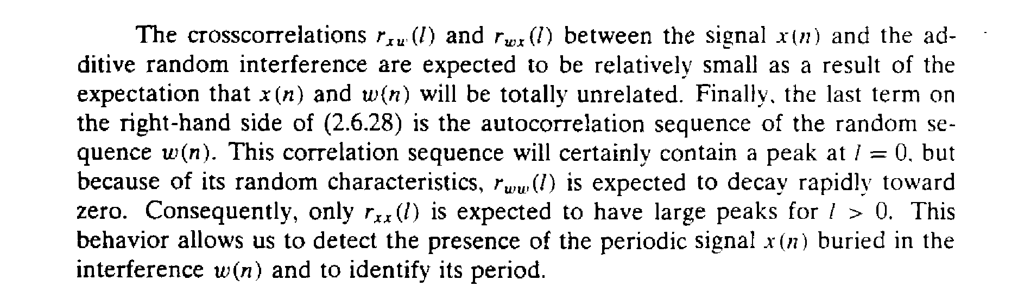

Slide 69
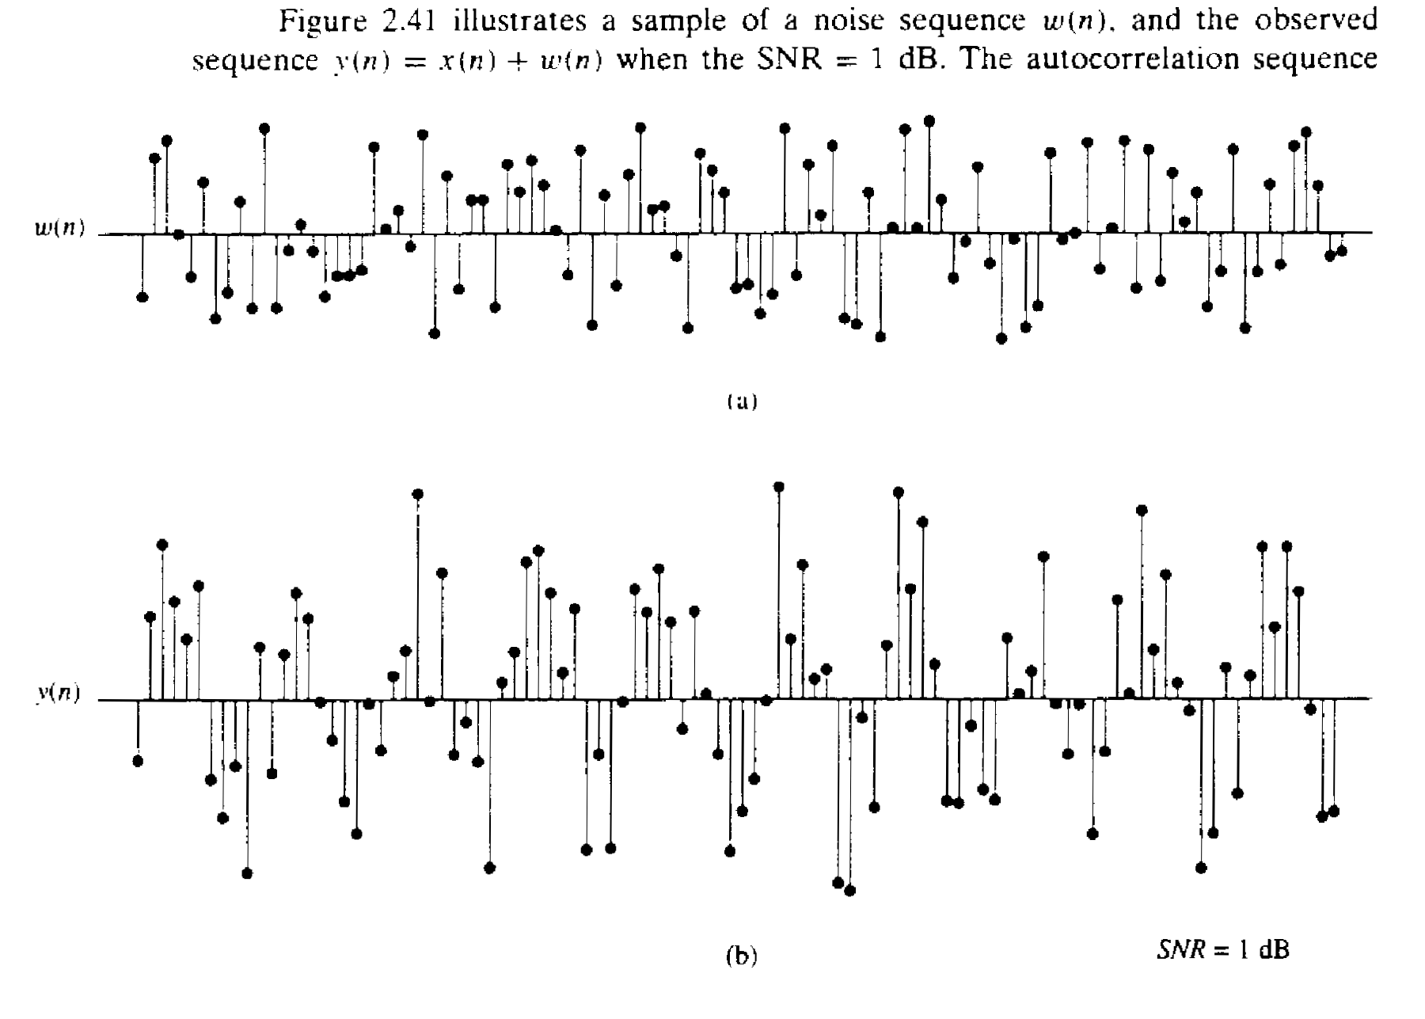
Noise: uniformly taken between – Δ/2 and + Δ/2, then noise power = Δ²/12
Signal: sine function with amplitude A = 1 V, then signal power = A²/2
SNR = 1 dB → A = 1 V and Δ = 2.23 volts

Slide 70
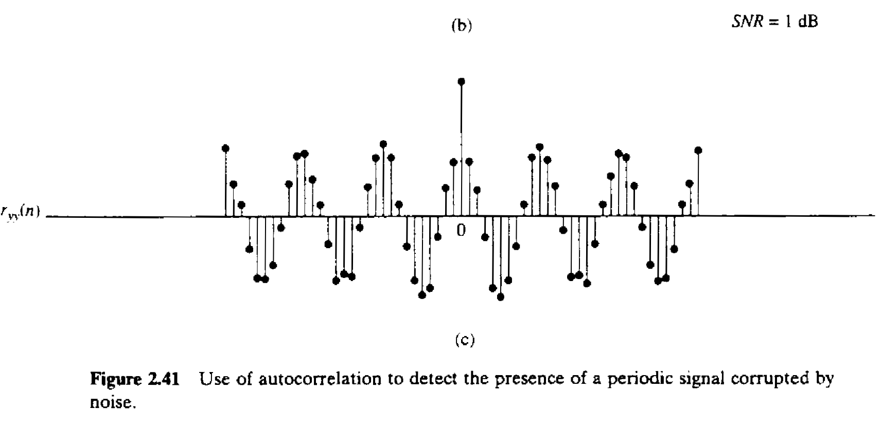

Slide 71
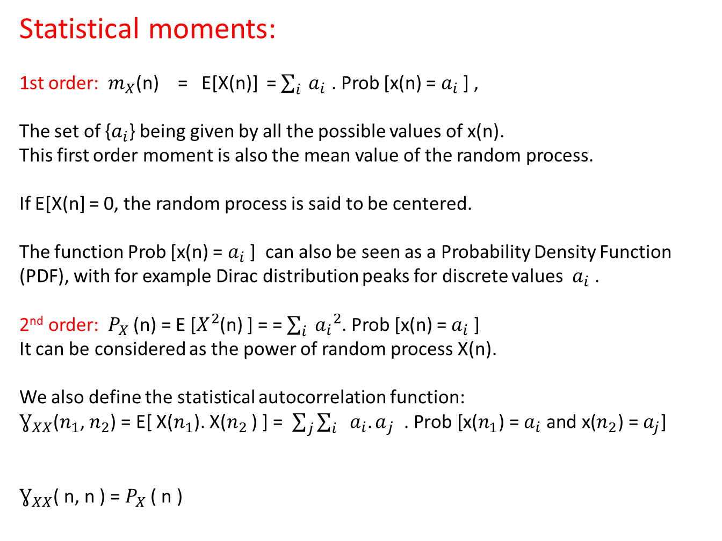
Statistical moments:
1st order: $m_{X}$(n) = E[X(n)] = $\sum_{i}{{ a}_{i}}$ . Prob [x(n) = $a_{i}$ ] ,
The set of {$a_{i}$} being given by all the possible values of x(n).
This first order moment is also the mean value of the random process.
If E[X(n] = 0, the random process is said to be centered.
The function Prob [x(n) = $a_{i}$ ] can also be seen as a Probability Density Function (PDF), with for example Dirac distribution peaks for discrete values ${ a}_{i}$ .
2nd order: $P_{X}$ (n) = E [$X^{2}$(n) ] = = $\sum_{i}{{{ a}_{i}}^{2}}$. Prob [x(n) = $a_{i}$ ]
It can be considered as the power of random process X(n).
We also define the statistical autocorrelation function:
$Ɣ_{XX}$($n_{1}$, $n_{2}$) = E[ X($n_{1}$). X($n_{2}$ ) ] =$\sum_{j}{\sum_{i}{ {a_{i}. a}_{j}\text{ . }\text{Prob}\text{ [}\text{x}\text{(}n_{1}\text{) = }a_{i} \text{and} \text{x}\text{(}n_{2}\text{) = }a_{j}\text{]}}}$
$Ɣ_{XX}$( n, n ) = $P_{X}$ ( n )

Slide 72
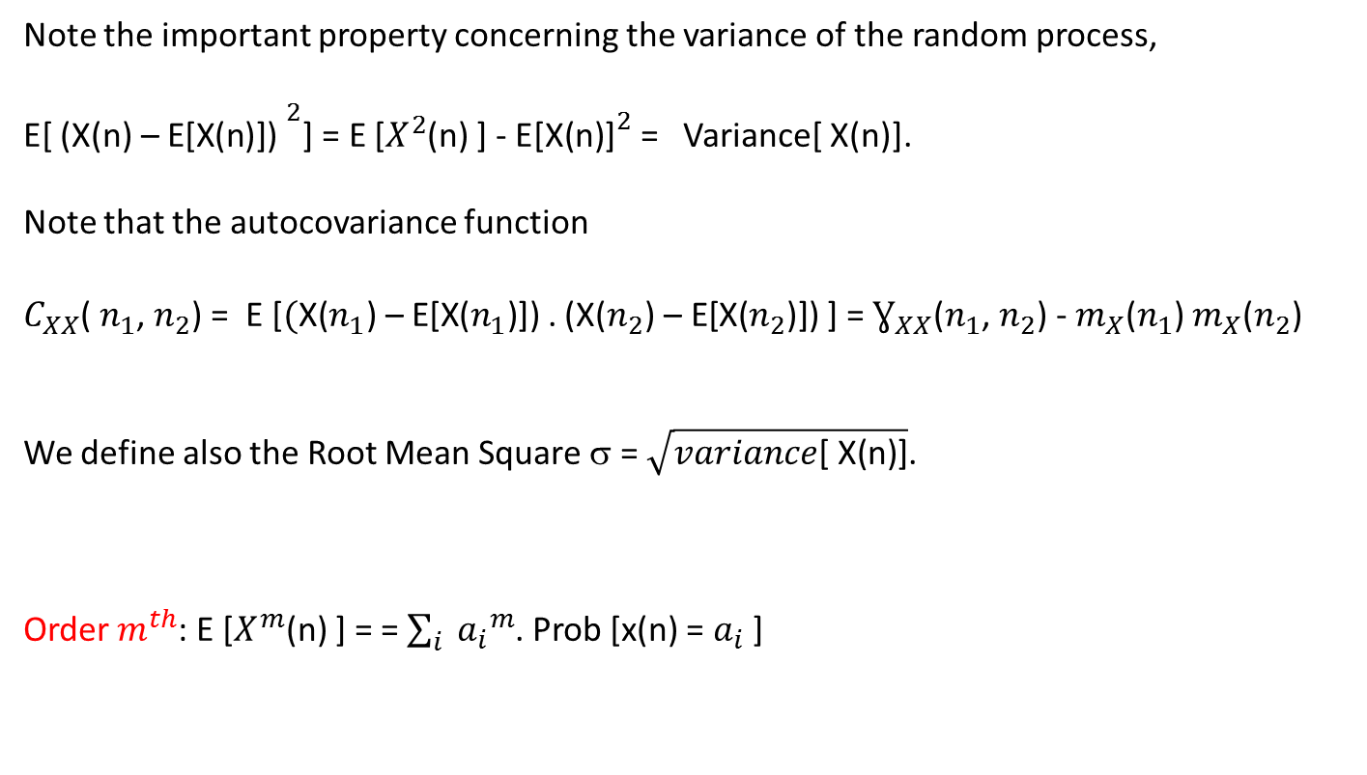
Note the important property concerning the variance of the random process,
E[ ${\text{(}\text{X}\text{(}\text{n}\text{) – }\text{E}\text{[}\text{X}\text{(}\text{n}\text{)]) }}^{2}$] = E [$X^{2}$(n) ] - ${\text{E}\text{[}\text{X}\text{(}\text{n}\text{)]}}^{2}$ = Variance[ X(n)].
Note that the autocovariance function
$C_{XX}$( $n_{1}$, $n_{2}$) = E [$(\text{X}\text{(}n_{1}\text{) – }\text{E}\text{[}\text{X}\text{(}n_{1}\text{)]) }$. ($\text{X}\text{(}n_{2}\text{) – }\text{E}\text{[}\text{X}\text{(}n_{2}\text{)]) }$] = $Ɣ_{XX}$($n_{1}$, $n_{2}$) - $m_{X}$($n_{1}$) $m_{X}$($n_{2}$)
We define also the Root Mean Square σ = $\sqrt{variance\text{[ }\text{X}\text{(}\text{n}\text{)]}}$.
Order $m^{th}$: E [$X^{m}$(n) ] = = $\sum_{i}{{{ a}_{i}}^{m}}$. Prob [x(n) = $a_{i}$ ]

Slide 73
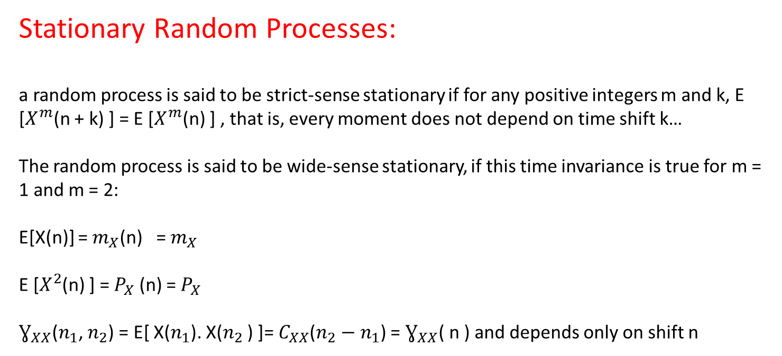
Stationary Random Processes:
a random process is said to be strict-sense stationary if for any positive integers m and k, E [$X^{m}$(n + k) ] = E [$X^{m}$(n) ] , that is, every moment does not depend on time shift k…
The random process is said to be wide-sense stationary, if this time invariance is true for m = 1 and m = 2:
E[X(n)] = $m_{X}$(n) = $m_{X}$
E [$X^{2}$(n) ] = $P_{X}$ (n) = $P_{X}$
$Ɣ_{XX}$($n_{1}$, $n_{2}$) = E[ X($n_{1}$). X($n_{2}$ ) ]= $C_{XX}$($n_{2}−n_{1}$) = $Ɣ_{XX}$( n ) and depends only on shift n

Slide 74
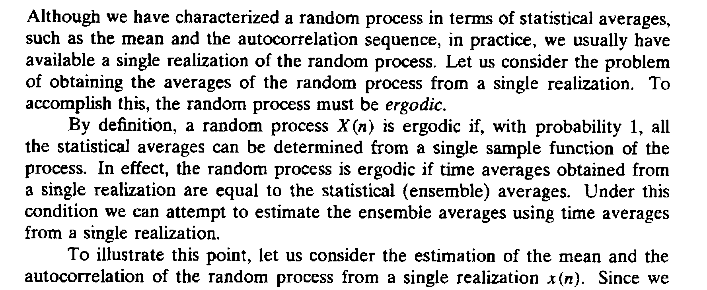
Time Averages or temporal mean values:
Namely, a process X(n) is said to be ergodic if its statistical properties are the same as the time properties of each of its sample sequence x(n) (or single realization x(n)).

Slide 75
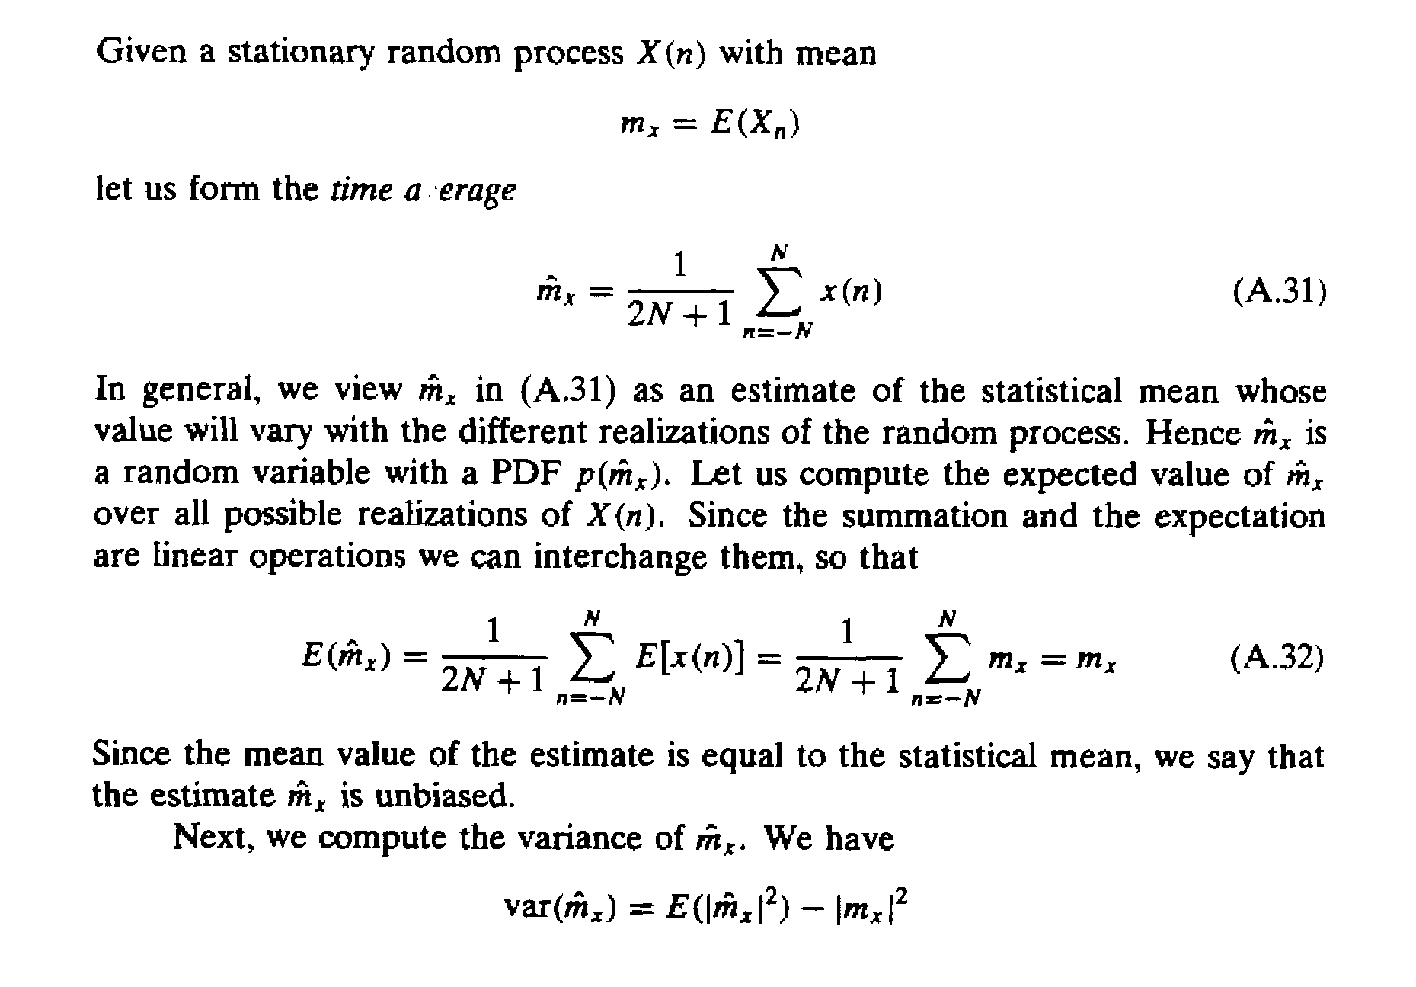

Slide 76
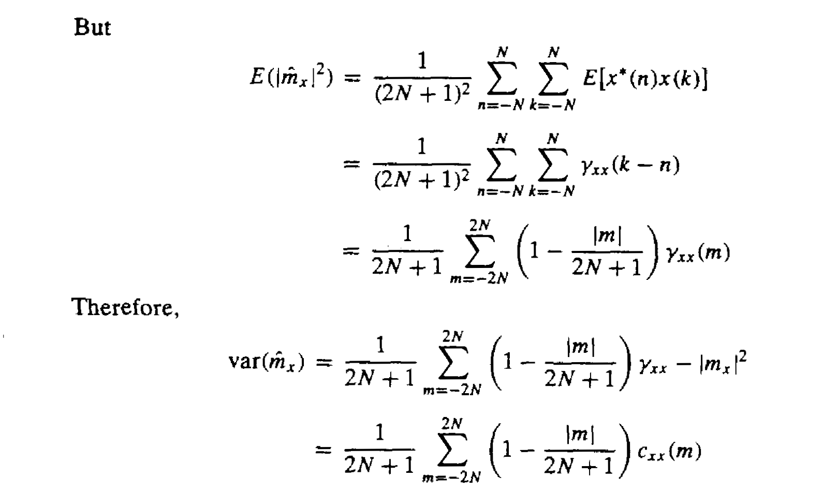

Slide 77
